Slide 1
What can OSS mailing lists tell us?
A preliminary psychometric text analysis of the Apache developer mailing list
Peter C. Rigby, Ahmed E. Hassan
PRESENTOR: NUR ATHIRAH

Slide 2
AIM
Evaluate: 評価する Appropriateness:適切さ
Extraction:抽出
To evaluate the appropriateness of LIWC tool for information extraction from mailing lists
Notes:
To check whether LIWC tool is suitable for extracting information from mailing lists

Slide 3
RESEARCH QUESTIONS
RQ1:What is the personality type of OSS developers?
RQ2: Does the language and attitude of a developer change as he or she moves from being a new, to a current, to a departing developer?
RQ3:Does word usage change around the time of a release?

Slide 4
WHAT IS LIWC?
Sarcasm:皮肉
Irony:アイロニー
Contextual:文脈
Psychometrically: 心理測定的に
Linguistic Inquiry and Word Count (LIWC)
Based on counting function words or particles
Cannot catch sarcasm, irony, or a given contextual meaning
Dictionary that divides the different counts into meaningful dimensions
Uses a psychometrically-based dictionary
Notes:
Stands for linguistic inquiry and word count
Based on counting function words or particles
Word count programs cannot catch sarcasm, irony, or a given contextual meaning for words with many meanings
The power of a word count tool lies in the dictionary that divides the different counts into meaningful dimensions
The LIWC uses a psychometrically-based dictionary

Slide 5
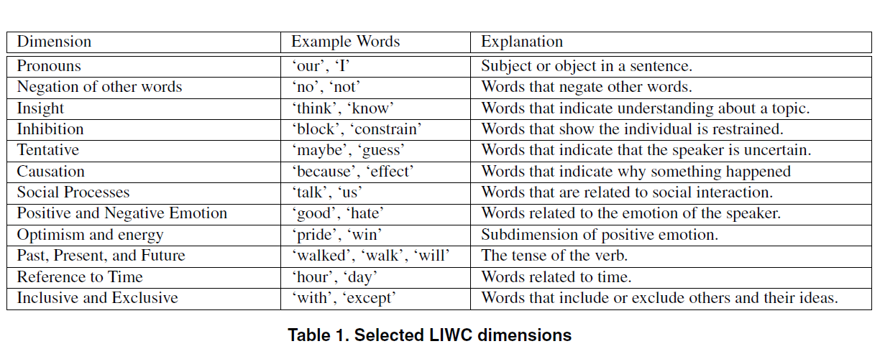
WHAT IS LIWC?
3 top level categories used:
  Language composition
  Psychological processes
  Relativity
Notes:
3 top level categories used in this study:
Language composition consists of the standard word count dimensions such as pronouns, total words, and articles
Psychological processes is subdivided into emotional, cognitive and social processes.
Relativity is divided into temporal references and past tense verbs

Slide 6
METHOD
Need mailing list data
The Apache httpd server project
- A large, successful, mature OSS project
Extracted the body of all email messages (1995 ~2005)
- Approx. 104,000 emails
Select four developers that had the most commits for a given two year period
Notes:
need mailing list data
choose to study the Apache httpd server project because it is a large, successful, mature OSS project
extracted the body of all email messages on this mailing list between 1995 and 2005 – approximately 104,000 emails.
Select four developers that had the most commits for a given two year period

Slide 7
EXPERIMENTS
PERSONALITY
NEW, CURRENT AND DEPARTING DEVELOPERS
RELEASES

Slide 8
1) PERSONALITY
Extroversion: 外向性
Openness: 開放性
Agreeableness: 同意度
Conscientiousness: 念入れ
What is the personality type of OSS developers?
Certain LIWC dimensions were correlated to the big five personality
The big five personality factors:
  Neuroticism
    Express negative emotions such as anger
  Extroversion
    Seek the company of others
  Openness
    Understand and respect unusual ideas
  Agreeableness
    Be cooperative
  Conscientiousness
    Be self-disciplined and diligent
Notes:
What is the personality type of OSS developers?
certain LIWC dimensions were correlated to the big five personality
The big five personality factors:
Neuroticism the tendency to express negative emotions such as anger.
Extroversion the tendency to seek the company of others.
Openness the ability to understand and respect unusual ideas
Agreeableness the tendency to be cooperative rather than antagonistic
Conscientiousness the tendency to be self-disciplined and diligent
We first create a baseline by assessing the LIWC dimensions for individuals
who make few posts to the mailing list (i.e., between 1 and
30 messages) as well as for the remainder of the mailing list
(i.e., 31 or more messages), excluding the top four committers.
We then calculate the LIWC dimensions for the top
four committers and compare them to the baselines. These
baselines allow us to assess whether top committers have a
different personality type from the general trend on the entire
mailing list. We further compare the top committers to
each other. We refer to the two baselines and the developers
as subjects.
a baseline for individuals
make few posts to the mailing list (i.e., between 1 and 30 messages)
the remainder of the mailing list (i.e., 31 or more messages), excluding the top four committers.
calculate the LIWC dimensions for the top four committers and compare them to the baselines
further compare the top committers to each other

Slide 9
1) PERSONALITY
Hypothesize:
  Top committers will have a similar personality type to each other
  The personality of top committers will differ from that of the entire mailing list
Top committers will be:
  Less neurotic
  More extroverted
  More open
  More agreeable
  More conscientious
E.g. successful leaders will be more open to others’ ideas
Notes:
hypothesize that top committers will have a similar personality type to each other, and that the personality of top committers will differ from that of the entire mailing list
top committers will be:
less neurotic
more extroverted
more open
more agreeable
more conscientious
than the general mailing list
For example, we feel that successful leaders will be more open to others’ ideas than the general population.

Slide 10
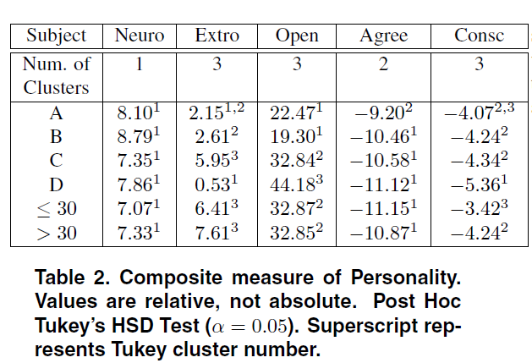
1) PERSONALITY
less extroverted, less open, but equally conscientious
Notes:
With the exception of agreeableness developer A and B belonged to the same clusters for all the measures.
These developers were the top developers during the development of Apache 1.3 and 2.0 respectively.
Developer C and the general mailing list population (> 30 messages) were the same for all measures.
Developer D was not consistently associated with any other subject.
Comparing developers A and B to developer D and the general mailing list,
developers A and B were less extroverted, less open, but equally conscientious.
Developers A and B, who were responsible for the two significant Apache releases, are similar to each other but
differ from the general mailing list population in that they are less extroverted and less open

Slide 11
2) NEW, CURRENT AND DEPARTING DEVELOPERS
Does the language and attitude of a developer change as he or she moves from being a new, to a current, to a departing developer?
Examine how developers change throughout their time with the project
Two top committers who have left the project
- compare the word usage of first and last 50 emails
Notes:
Does the language and attitude of a developer change as he or she moves from being a new, to a current, to a departing developer?
Using the LIWC we hope to examine, in an automated fashion, how developers change throughout their time with the project
examine the top committers for which we have resolved email addresses.
For the two top committers who have left the project we compare the word usage of their first and last 50 emails.

Slide 12
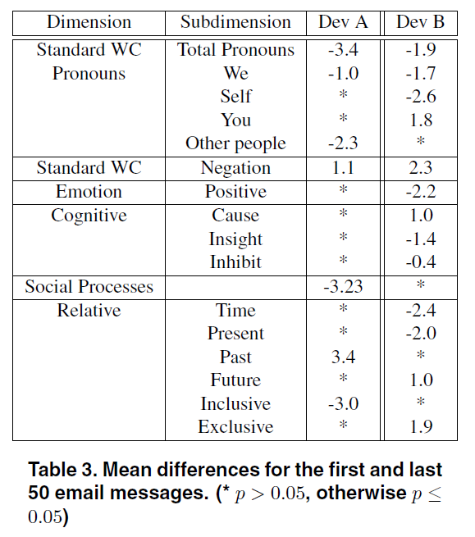
2) NEW, CURRENT AND DEPARTING DEVELOPERS
Notes:
Despite making few commits in his last three years, developer A continued to post to the mailing list.
From the large increase in past tense verbs it is likely that developer A would answer questions about things he had done in the past.
Further evidence is the increase of negations (e.g., ‘no’, ’never’), which could indicate a person telling someone else how something was not done.
He was more sociable and used more pronouns when he first began.
Once developer B stopped committing, he also stopped posting to the mailing list.
Developer B appears to have shifted from the use of pronouns that included himself, to more instructive ’you’ pronouns.
Discussion of time in general and the present was higher at first, with discussion of the future increasing before he left.
There was a decrease in the number of positive emotions.
Words related to insight decreased as he was leaving, while causal words and exclusive words increased.
This may be indicative of a change where developer B moved from producing new insights to explaining the cause or arguing why a particular solution will not work with the way the code is structured.
The decrease in positive emotions, increase in instruction, potential shift from creator to critic, and increased discussion of
the future is indicative of someone whose role has changed, but as we have seen, will be leaving the project shortly.

Slide 13
3) RELEASES
Does word usage change around the time of a release?
A consistent change in word usage before and after a release
Examine the Apache 1.3 and 2.0 releases
Notes:
Does word usage change around the time of a release?
interested in discovering if there is a consistent change in word usage before and after a release.
examine the Apache 1.3 and 2.0 releases (two major releases) by categorizing emails as occurring either a month before or after a release

Slide 14
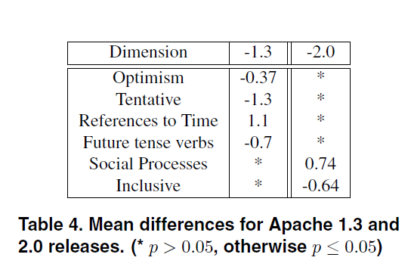
3) RELEASES
Optimism: 楽観
Tentative:仮の
Notes:
From table 4 we can see that
discussion before the Apache 1.3 release was
more optimistic, more tentative, used more future tense verbs, and was less about actual times than after the release.
developers are often optimistic before a release and then less optimistic when the users start reporting bugs.
Examining the Apache 2.0 release, we see that after the release there were more social and less inclusive words than before the release.
There is no overlap in the LIWC dimensions that are statistically significant between the two releases
the atmosphere surrounding each of the releases was different.
For example, with the 2.0 release, sociability seems to have increased after
the release, and there is no statistically significant change
in optimism as there was for the 1.3 release.
The differences between the two releases suggest that it is unlikely that we will be able to predict when a release will occur.

Slide 15
LIMITATIONS
Bias: バイアス
Representative:代表
Preliminary:予備
Validation:検証
The LIWC was created as tool to measure various psychological phenomenon
The LIWC may be biased against individuals who’s first language is not English
Apache httpd server may not be representative of OSS development in general
The three experiments were preliminary
Further experimentation and validation are needed
Notes:
The LIWC was created as tool to measure various psychological phenomenon
It has been used in a variety of environments, but to our knowledge, has not be used to understand OSS developers.
the LIWC may be biased against individuals who’s first language is not English.
although the Apache httpd server is a large, successful, mature project, it may not be representative of OSS development in general.
the three experiments that we performed were preliminary
As such, they had a limited number of developers and project releases.
Further experimentation and validation must be performed before any of our results can be generalized.

Slide 16
CONCLUSIONS
First attempt at using a psychometrically-based word count tool to understand OSS mailing lists
Used the LIWC dictionary
Conducted three preliminary experiments on the Apache httpd server’s developer mailing list
  Proposed directions for future research
Notes:
represents a first attempt at using a psychometrically-based word count tool to understand OSS mailing lists
used the LIWC dictionary
conducted three preliminary experiments on the Apache httpd server’s developer mailing list and proposed directions for future research
The general conclusions from each experiment are as follows.

Slide 17
CONCLUSIONS
Baseline: ベースライン
1) Personality
Created a baseline personality score for the entire mailing list
  Compared the top four committers to the baseline and to each other
The two developers that were responsible for two major Apache releases
  Had similar personalities
  Had different personalities from the baseline and other developers
Future work:
  Run further comparisons with other projects
  Examine the effect of a developer’s role on his or her personality
Notes:
1) Personality
Using the LIWC dimensions that are correlated with the big five personality traits, we created a baseline personality score for the entire mailing list (excluding the top four committers) and compared the top four committers to the baseline and to each other
The two developers that were responsible for two major Apache releases had similar personalities
Their personalities were different from the baseline and other developers on the traits of extroversion and openness
We plan to run further comparisons with other projects as well as examine the effect of a developer’s role on his or her personality.

Slide 18
CONCLUSIONS
Significant: 重要な
Consistent: 一貫した
2) New, Current, and Departing Developers.
Two top committers who have left the Apache project
  Extracted the LIWC dimensions for their first and last 50 emails
The statistically significant LIWC dimensions are consistent
Dividing developers’ emails into:
  Equal groups
    Span multiple events
    Produce statistically nonsignificant results
  Event based periods
    Produce more interesting results
Future work:
  Characteristics of past successful and unsuccessful developers
    Predict whether a newcomer will become a successful member of the development team
Notes:
2) New, Current, and Departing Developers.
For the two top committers who have left the Apache project, we extracted the LIWC dimensions for their first and last 50 emails
They feel that the statistically significant LIWC dimensions are consistent with our initial manual analysis of the developers.
Dividing developers’ emails into equal groups appears to span multiple events and produce statistically nonsignificant results
Dividing developers’ emails into event based periods would likely produce more interesting results.
In the future, we would like to develop a measure based on the LIWC dimensions and the characteristics of past successful and unsuccessful developers that would predict whether a newcomer will become a successful member of the development team.

Slide 19
CONCLUSIONS
3) Releases
Calculated one month before and one month after the releases of Apache 1.3 and 2.0
1.3 release
  Had higher pre-release levels of optimism
2.0 release
  Had higher post-release levels of social words
No common statistically significant LIWC dimensions
Did not take into account the success of each release
Future work:
  Assess the “attitude” of developers around successful and failed releases
Notes:
3) Releases.
We calculated the LIWC dimensions one month before and one month after the releases of Apache 1.3 and 2.0.
The 1.3 release had higher pre-release levels of optimism.
The 2.0 release had higher post-release levels of social words.
There were no common statistically significant LIWC dimensions between the two releases.
However, we did not take into account the success of each release.
Based on the finding at Microsoft that developers can predict more accurately than project managers when a release will occur, we plan to use the LIWC dimensions to assess the “attitude” of developers around successful and failed releases

Slide 20
CONCLUSIONS
Insight: 洞察力
Gained some insight:
  Type of people who participate
  Discussions that occur on the Apache mailing list
Attempted to:
  Determine the personality types of four top developers
  Understand why developers join and leave a project
  Examine the general attitude of developers before and after a release
Show promise for future work
Notes:
They feel that the they have gained some insight into the type of people who participate in and the discussions that occur on the Apache mailing list
They have attempted to determine the personality types of four top developers,
to understand why developers join and leave a project, and to examine the general attitude of developers before and after a release
Each experiment presented unique difficulties, but all show some promise for future work

Slide 21
EXTRA

Slide 22
LIWC
1. I sent these patches in a couple weeks ago. They may be of interest, maybe not.
2. This patch fixes the important half of the bug.
First quotation, the author is uncertain
Second quotation, the author seems confident
Words like
  ‘maybe’ → tentativeness
  ‘important’ → certainty
only counts words that are contained in its dictionary
grouped into basic linguistic and psychometric dimensions
  each word belonging to one or more dimension
Notes:
In the first quotation, it appears that the author is uncertain as to the value of his contribution.
In the second quotation, the author seems confident.
Words like ‘maybe’ are associated with tentativeness and
words like ‘important’ are associated with certainty.
The LIWC tool simply counts words that are contained in its dictionary.
The dictionary is grouped into basic linguistic and psychometric dimensions with each word belonging to one or more dimension

Slide 23
1) PERSONALITY
Notes:
For neuroticism, there is no statistically significant differences among the subjects.
Since the developers do not vary significantly from the general mailing list population, it is likely that the top committers are not emotionally unstable individuals.
The least extroverted developer is developer D.
Developer A and B have intermediate levels of extroversion.
Developer C and the general mailing list population are the most extroverted.
It appears that the top committers are less extroverted than the general mailing list population.
Developer D has the highest openness score.
While Developer A and B have the lowest scores.
Developer C matches the general mailing list population.
No obvious pattern emerges from the openness measure.
Developer A is the most agreeable developer.
There is no difference among the other developers and the general population.
Conscientiousness is the only measure in which the two general mailing list subjects differ.
Individuals who have sent less than 30 messages appear to be the most conscientious.
This result is counter to our hypothesis.
One possible explanation is that individuals who send few messages are intimidated by the regular project members and are very conscientious about what they write.
Developer A belongs to both the highest and intermediate clusters.
While Developers B, C, and the general mailing list population belong to the intermediate level.
Developer D appears to be the least conscientious.

