Slide 1

An Analysis of Committers Towards Improving the Patch Review Process in OSS Development
Shoji Fujita, Masao Ohira, Akinori Ihara, Ken-ichi Matsumoto
Graduate School of Information Science
Nara Institute of Science and Technology, JAPAN
Notes:
Good Morning. My name is Shoji Fujita. I am a masters course student at Nara Institute of Science and Technology in Japan.
My presentation today is about “An Analysis of Committers towards Improving the Patch Review Process in OSS development”

Slide 2
Introduction
Open Source Software (OSS) has become important for modern society
  OSS developers are expected to fix bugs as soon as possible
Bug modification is conducted through a patch review process, but some OSS projects receive a large number of bug reports on a daily basis[1]
Improvement of the patch review process is required
[1] Hailpern B., Santhanam P.: Software debugging, testing, and verification, IBM Systems journal, pp.4-12, 2002.
Notes:
In recent years, Open Source Software has become important for modern society.
Since OSS has become so important, OSS developers are expected to fix bugs as soon as possible.
In OSS development, a patch review process is used for bug modification.
However, some OSS projects receive a large number of bug reports on a daily basis.
As the number of bug reports increases, some bugs are neglected by developers.
Because of this, the patch review process needs improvement.

Slide 3


The Patch Review Process in OSS
Create
Edit
Developer
Submission
Feedback
Submission
Feedback
Review
Review
Committer
Commit
Commit
Source code repository
General Flow of the Patch Review Process
  ① Create and submit a patch
  ② Review a submitted patch
  ③ Commit the patch to the source code repository or
  Give feedback to the developer who submitted the patch
  ④ Edit and re-submit a patch
Notes:
At this point, I’d like to show you the existing patch review process generally used in OSS development and explain our terms.
In our research, developers include both non-committers and committers.
Committers are the developers who have commit permission to the source code repository.

Slide 4
The Patch Review Process in OSS
PRT
PET
PRT
Create
Edit
Developer
Submission
Feedback
Submission
Feedback
Review
Review
Committer
Commit
Commit
Source code repository
Patch Review Time (PRT)
  The time from patch submitted to the end of review
Patch Edit Time (PET)
  The time from the end of review to the edited patch re-submitted
Number of Patch Reviews (NPR)
Number of Patch Edits (NPE)
Notes:
We define the Patch Review Time or PRT as the time from patch submitted to the end of review.
Patch Edit Time or PET as the time from the end of review to the edited patch re-submitted.
We also used the acronyms NPR for Number of Patch Reviews and NPE for Number of Patch Edits.
The problem with this process occurs when…

Slide 5

A Problem in the Patch Review Process
PRT
PET
Create
Edit
Developer
Submission
Feedback
Submission
Review
Committer
Prolonged review time
Commit
Source code repository
Committers
Developers
Source code repository
Notes:
There are many developers and a relatively small number of committers.
The problem is
Many developers submit many patches to fix bugs.
Because of small number of committers, they cannot react quickly to the patches and have prolonged review time.
One solution is to give an appropriate developer commit permission.
This…

Slide 6
A Problem in the Patch Review Process
PRT
PET
PRT
Create
Edit
Developer
Submission
Feedback
Submission
Feedback
Review
Review
Committer
Commit
Commit
Reduced review time
Source code repository
Committers
Developers
Source code repository
Notes:
May reduce the review time or…

Slide 7
A Problem in the Patch Review Process
Create
Developer
Skip the review process
Commit
Committer
Important to find a reliable developer as a committer
Source code repository
Committers have a huge impact on OSS
Committers
Developers
Source code repository
Notes:
Some committers will create a patch and directly commit it to the source code repository, skipping the review process.
This is not necessary recommended.
However, committers have a large impact on OSS projects, so we have to carefully choose which developers are given commit permission.
Because of this, it is important to find a reliable developer as a committer.

Slide 8
Goal and Approach
Goal
  Improve the patch review process
Approach
  Select an appropriate developer as a committer
RQ1 : Time
Is there any difference in PRT and PET between committers and non-committers?
RQ2 : Frequency
Is there any difference in NPR and NPE between committers and non-committers?
RQ3 : Performance of committers
Is there any difference in performance between committers in the patch review process?
Notes:
Next, I’d like to explain the goal and approach of this research.
The goal of this research is to improve the patch review process for OSS development.
To achieve this goal, we want to select an appropriate developer to become a committer.
The following research questions are intended to help reveal indicators to select a new committer.
Research Question 1 looked at the times.
Is there any difference in Patch Review Time and Patch Edit Time between committers and non-committers?
Research Question 2 looked at the frequencies.
Is there any difference in the number of patch reviews and number of patch edits between committers and non-committers?
Research Question 3 looked at the performance of committers.
Is there any difference in performance between committers in the patch review process?

Slide 9
The Analysis Method
Investigate the time and frequency for the patch review process
  RQ1 : Patch Review Time (PRT) and Patch Edit Time (PET)
    Compare committers and non-committers
  RQ2 : Number of Patch Reviews (NPR) and Number of Patch Edits (NPE)
    Compare committers and non-committers
  RQ3：Performance between committers
    Classify committers by times and frequencies
Notes:
At this point, I would like to explain the analysis method.
To answer the 3 Research Questions we investigated the time and frequency of activities in the patch review process of both committers and non-committers.
For RQ1 we compared the times for committers and non-committers to see if there was any difference.
For RQ2 we compared the number of patch reviews and edits for committers and non-committers to see if there was any difference.
For RQ3, we classified the committers on the basis of times and frequencies.

Slide 10

The Case Study
OSS project
  PostgreSQL
Target Data
  ML archives (pgsql-hackers, pgsql-patches)
Analysis Period
  2001/01～2008/12 (8years)
 | Frequency | Committers | Non-Committers
Patch Review | 3352 | 14 | 200
Patch Edit | 1848 | 14 | 132
Notes:
For our research, we conducted a case study on the PostgreSQL project.
The target data was taken from Mailing List archives that the developers submit patches to.
The analysis period was from 2001 to 2008.
During this time, there were 3352 patch reviews, with 14 committers and 200 non-committers.
There were also 1848 patch edits, involving 14 committers and 132 non-committers.

Slide 11
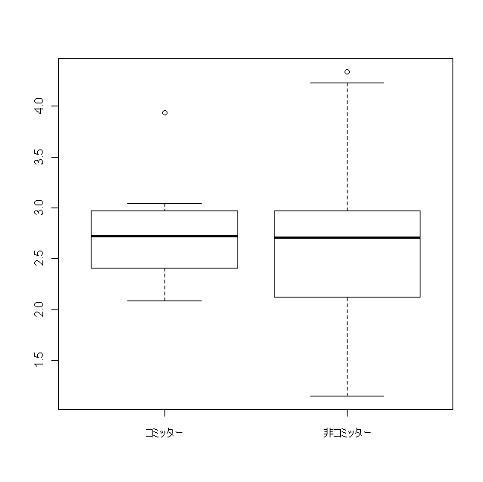
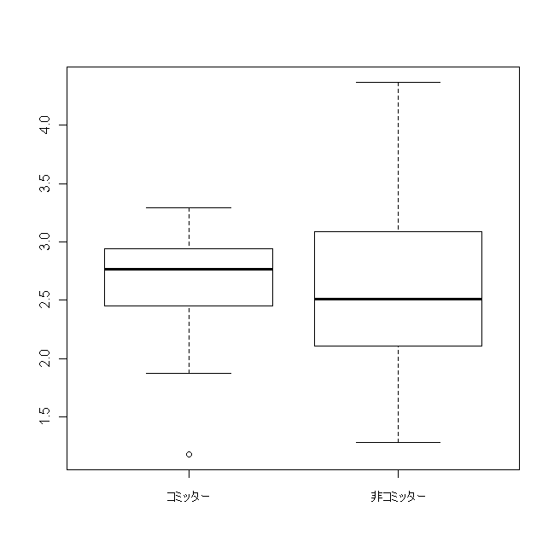
RQ1 : The PRT and PET Results
  Patch Review Time (PRT) Patch Edit Time (PET)
10000
1000
100
10000
1000
100
PRT (minutes)
PET (minutes)
Committers Non-Committers
Committers Non-Committers
p-value : 0.65(>0.05)
p-value : 0.48(>0.05)
No big difference between committers and non-committers
PRT and PET cannot be the indicator for selecting a committer
Notes:
I would like to explain the results.
At first, I investigated the Patch Review Time and Patch Edit Time statistics.
The left figure shows the distribution of committers and non-committers’ Patch Review Time.
The vertical axis shows the Patch Review Time in minutes and is log scaled.
The right figure shows the distribution of committers and non-committers’ Patch Edit Time.
The vertical axis shows the Patch Edit Time in minutes and is log scaled.
From the results, there is no big difference in the PRT and PET values between committers and non-committers.
Since there were no significant differences, PRT and PET cannot be used as the indicator for selecting a committer.

Slide 12
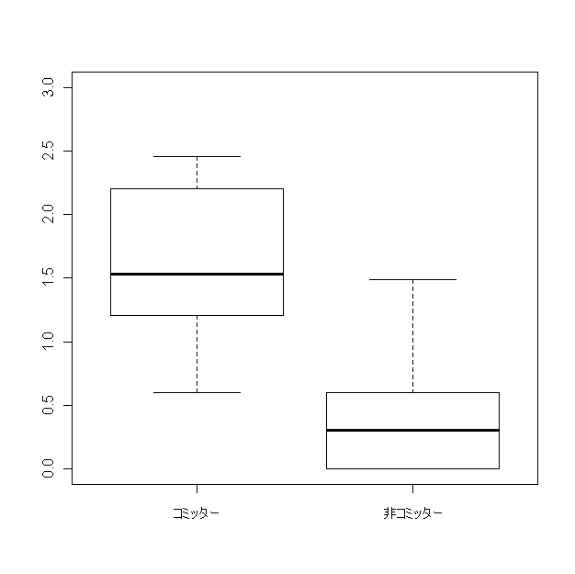
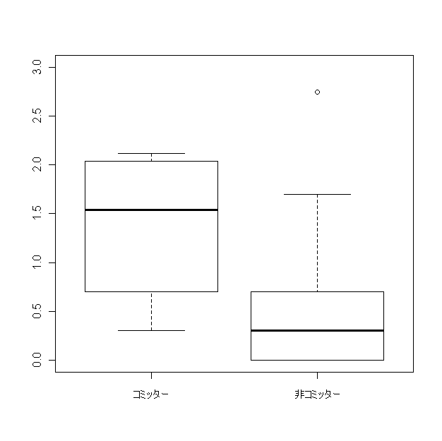
RQ2 : The NPR and NPE Results
  Number of Patch Reviews (NPR) Number of Patch Edits (NPE)
1000
100
10
1
1000
100
10
1
NPR
NPE
Committers Non-Committers
Committers Non-Committers
p-value : 0.00(<0.05)
p-value : 0.00(<0.05)
Significant difference between committers and non-committers
Number of patch reviews and edits can be one of the indicators for selecting a committer
There are some non-committers who show the same level of patch editing as committers
Notes:
For RQ2, we investigated the Number of Patch Reviews and Number of Patch Edits statistics.
.
The left figure shows the distribution of committers and non-committers’ Number of Patch Reviews.
The vertical axis shows the Number of Patch Reviews.
The right figure shows the distribution of committers and non-committers’ Number of Patch Edits
The vertical axis shows the Number of Patch Edits.
Also both vertical axis are in log scale.
From these results, committers have higher NPR and NPE than non-committers.
Since there is a significant difference between committers and non-committers, NPR and NPE can be used as the indicator for selecting a committer.
With this information in mind, please look at the right figure, where some non-committers highlighted in the red circle show the same level of patch editing as committers.

Slide 13
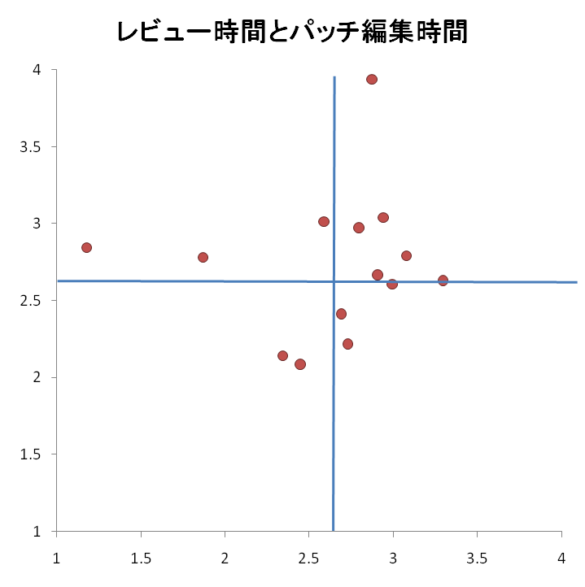
RQ3 : Committers’ performance
Time | PRT and PET
Patch Review | PRT and NPR
Patch Edit | PET and NPE
Frequency | NPR and NPE
Patch Review Time (PRT) and Patch Edit Time (PET)
10000
1000
100
10
PRT (minutes)
10 100 1000 10000
PET (minutes)
Committers spread into all four classified categories
Notes:
For RQ3, we investigated the committers’ performance.
At first, we focused on the time in the patch review process.
This figure shows the committers’ PRT and PET.
The horizontal axis shows the PET in minutes and the vertical axis shows the PRT in minutes.
Each red dot represents one committer.
The horizontal and vertical blue lines show the median PRT and PET for all developers (including both committers and non-committers)
This figure shows that the
Committers spread into all four classified categories, so this chart does not provide much help in identifying possible new committers.

Slide 14
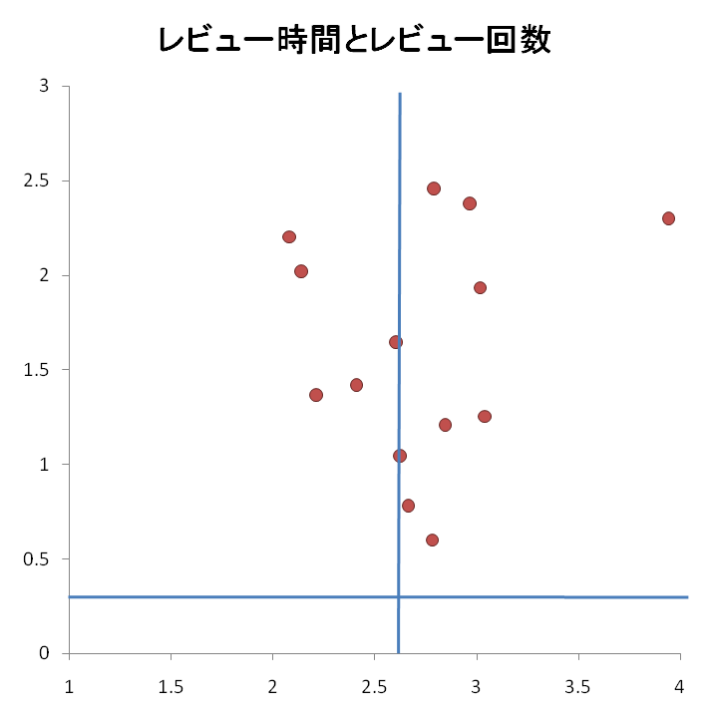
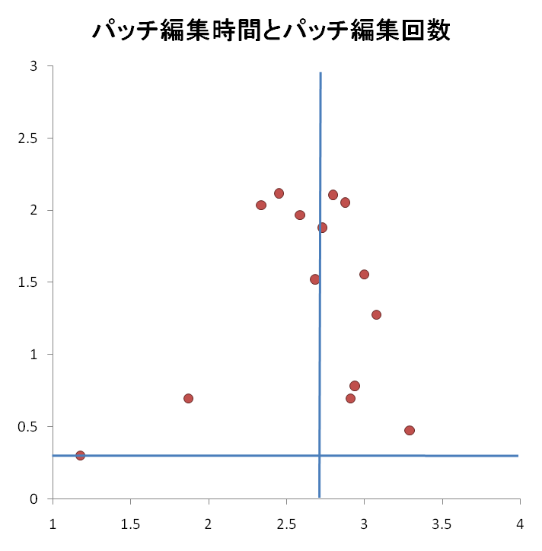
RQ3 : Committers’ performance
Time | PRT and PET
Patch Review | PRT and NPR
Patch Edit | PET and NPE
Frequency | NPR and NPE
Patch Review Time (PRT) and
Number of Patch Reviews (NPR)
Patch Edit Time (PET) and
Number of Patch Edits (NPE)
1000
100
10
1
1000
100
10
1
NPR
NPE
10 100 1000 10000
10 100 1000 10000
PRT (minutes)
PET (minutes)
For PRT and PET, committers divided into both longer and shorter categories
Time cannot be the indicator for selecting a committer
Notes:
Next we investigated the relationship between PRT and NPR, PET and NPE.
The left figure shows the committers PRT and NPR, while the right figure shows the committers’ PET and NPE.
From these figures, we can say the same thing as the previous slide.
So the time for the patch review process cannot be used as an indicator for selecting a committer.

Slide 15
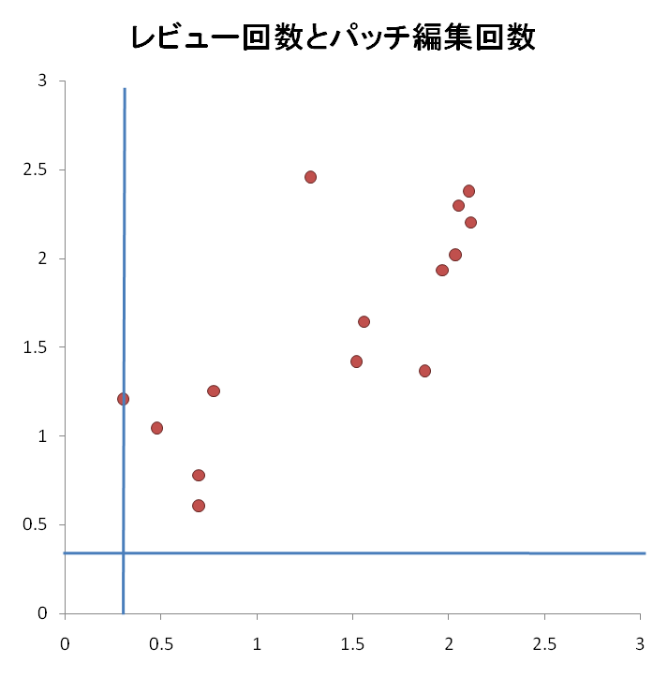
RQ3 : Committers’ performance
Time | PRT and PET
Patch Review | PRT and NPR
Patch Edit | PET and NPE
Frequency | NPR and NPE
Number of Patch Reviews (NPR) and
Number of Patch Edits (NPE)
1000
100
10
1
Coefficient of correlation: 0.77
NPR
1 10 100 1000
NPE
All committers’ NPR and NPE are higher than the median
Developers who have higher NPR and NPE than the median can be candidates for committers
Notes:
Finally, we investigated the relationship between the committers’ NPR and NPE. This figure shows the results.
From the results all committers have higher NPR and NPE than the median.
Also the coefficient of correlation between NPR and NPE was 0.77.
Therefore developers who have higher NPR and NPE than the median can be considered as candidates for committers.

Slide 16
An Additional Research Question
A reviewer’s feedback said…
The statement “committers have higher NPR and NPE than non-committers” seems to be too NORMAL
  Because committers are more likely to participate more than non-committers
So…
We have to look at the normalized contributions
Notes:
However, as this paper’s reviewer pointed out
the statement “committers have higher NPR and NPE than non-committers” seems to be too normal.
This is because committers are more likely to participate longer than non-committers.
So we have to look at the normalized contributions.

Slide 17
An Additional Research Question
RQ4 : Normalized Frequencies
Is there any difference in the average NPR and NPE per month between committers and non-committers?
We collected the data as follows
  Average NPR per month (NPRave)
    NPRave = NPR / t
  Average NPE per month (NPEave)
    NPEave = NPE / t
t indicates the participation period in months
Notes:
Next we conducted another analysis to answer the additional Research Question posed by a reviewer.
Which is RQ4;
“Is there any difference in the average NPR and NPE per month between committers and non-committers?”
We collected the average number of patch reviews and edits per month as shown in these equations.
Where t indicates the participation period in months when the developer did at least one patch review or edit.

Slide 18
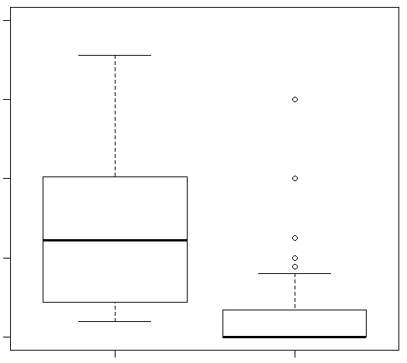
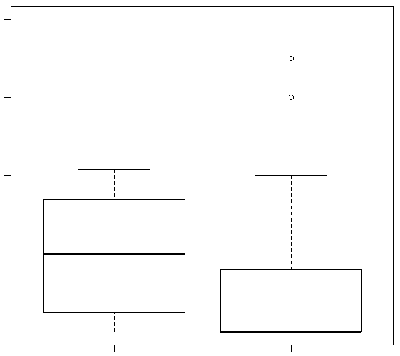
RQ4 : The average NPR and NPE per month
Average Number of Patch Reviews (NPR) per month
Average Number of Patch Edits (NPE) per month
5
4
3
2
1
5
4
3
2
1
NPRave
NPEave
p-value : 0.00(<0.05)
Committers Non-Committers
Committers Non-Committers
p-value : 0.00(<0.05)
p-value : 0.00(<0.05)
Significant difference between committers and non-committers
A Developer who works many times in the patch review process in a specific time period tends to be a committer
Notes:
These are the results of RQ4 in terms of the distribution of the developers’ average NPR and NPE per month.
The left figure shows the average NPR per month and the right figure shows the average NPE per month.
From the results committers tend to have a higher average of NPR and NPE per month than non-committers and there is a significant difference between committers and non-committers.
Therefore a developer who works many times in the patch review process in a specific period tends to be a committer.

Slide 19
Conclusions and Future Work
Conclusions
  We analyzed the differences in performance between committers and non-committers and found;
    Time cannot be the indicator for selecting a committer
    Frequency can be one of the indicators for selecting a committer
    Developers who have a higher NPR and NPE than the median can be a candidate for committer
This should allows better selection of committers, which will improve the patch review process in OSS development
Notes:
Finally, I’d like to go over the conclusions and future work.
We analyzed the differences in performance between committers and non-committers and found;
Time cannot be the indicator for selecting a committer
Frequency can be one of the indicators for selecting a committer
Developers who have a higher NPR and NPE than the median can be candidates for committers
These conclusions should allow better selection of committers, which will improve the patch review process in OSS development.

Slide 20
Conclusions and Future Work
Future Work
  Consider patch quality
    Patch acceptance rate, Number of bugs inserted in a patch
  Analyze committers activity before and after gaining a commit permission
  Generality of the analysis
    Conduct more case studies on multiple types of OSS
    Conduct case studies on industrial software
Notes:
For our Future Work, we have to
Consider patch quality such as the Patch acceptance rate and Number of bugs inserted in a patch
We also want to Analyze committers activity before and after gaining the commit permission
Finally, we only conducted one case study of the PostgreSQL project,
We should conduct more case studies on multiple types of OSS, and if possible, industrial software development.
Thank you for listening.

Slide 21
Thanks for listening!
Any Questions?
Shoji Fujita
shoji-f@is.naist.jp
http://se.naist.jp/~shoji-f/index_eng.html

Slide 22
Definition of developers
Developers (includes both committers and non-committers)
  Committers
    ○Review
    ○Edit
      Able to commit directly to the source code repository
  Non-Committers
    △Review
      Not able to commit
    ○Edit

Slide 23

Analysis Method
Collecting Data
  PRT, NPR, PET and NPE
mail01 [From : A] :______________
patch01.c
PRT
mail02[From : B] : Re:______________
PET
PRT
PET
mail03 [From : A] : Re: Re:______________
patch02.c
mail04 [From : C] : Re:______________
mail05 [From : D] : Re:______________
patch03.c
Submit Message Information |  |  | Reply Message Information |  |  | Time | Action
ID | Submit time | Name | ID | Reply time | Name | (minutes)
mail01 | 2010/4/20 9:55 | A | mail02 | 2010/4/20 13:18 | B | 203 | Review
mail02 | 2010/4/20 13:18 | B | Mail03 | 2010/4/20 15:53 | A | 155 | Edit
mail01 | 2010/4/20 9:55 | A | mail04 | 2010/4/20 21:40 | C | 705 | Review
mail01 | 2010/4/20 9:55 | A | mail05 | 2010/4/21 2:38 | D | 1003 | Edit

Slide 24
Statistics
PRT | All developers | Non-committers | Committers
# Developers*1 | 64 | 50 | 14
Median | 507.50(2.71) | 507.50(2.70) | 533.00(2.72)
Average | 1479.07(3.17) | 1579.25(3.20) | 1121.29(3.05)
Standard dev | 3572.63(3.55) | 3875.23(3.59) | 2132.97(3.33)
PET | All developers | Non-committers | Committers
# Developers*2 | 50 | 36 | 14
Median | 411.00(2.61) | 324.50(2.51) | 583.00(2.77)
Average | 1188.88(3.07) | 1394.47(3.14) | 660.21(2.82)
Standard dev | 3317.03(3.52) | 3877.61(3.59) | 493.46(2.69)
NPR | All developers | Non-committers | Committers
# Developers | 214 | 200 | 14
Median | 2.00(0.30) | 1.00(0.00) | 35.00(1.54)
Average | 15.55(1.19) | 10.56(1.02) | 86.93(1.94)
Standard dev | 100.93(2.00) | 99.65(1.99) | 91.79(1.96)
NPE | All developers | Non-committers | Committers
# Developers | 146 | 132 | 14
Median | 2.00(0.30) | 1.00(0.00) | 34.50(1.54)
Average | 12.62(1.10) | 8.24(0.92) | 53.93(1.73)
Standard dev | 50.24(1.70) | 48.33(1.68) | 49.18(1.69)
＊1 Developers with 5 or more patch reviews
＊2 Developers with 5 or more patch edits

