Slide 1
Relink: Recovering Links between Bugs and Changes
Author: Rongxin Wu , Sunghun Kim, S.C. Cheung
School of Software, Tsinghua University
The Hong Kong Uneversity of Science and Technology
Proceedings of the 19th ACM SIGSOFT symposium and the 13th European conference on Foundations of software engineering
Pages 15-25

Slide 2
Links
The links between fixed bugs and committed changes are important:
  For measuring software quality
  For constructing defect prediction models
Bugzilla
CVS/SVN
Fixed Bugs
Committed Changes

Slide 3
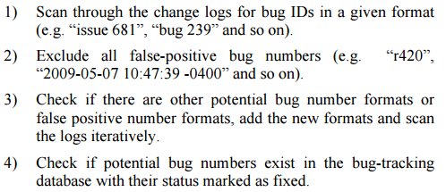
Traditional Heuristics
Proposed by Bachmann and Bemstein.
Software process data quality and characteristics – a historical view on open and closed source projects.

Slide 4
Missing Links!
Source Code Repository
all commits
{Bug fixes}
{commit}
{commit}
{commit}
Linked bug fixes
{commit}
{commit}
Bug Database
all bugs
Fixed bugs
{commit}
{commit}
{commit}
Linked bug fixes
{commit}
{commit}
Related,
But not linked
Linked via log message

Slide 5
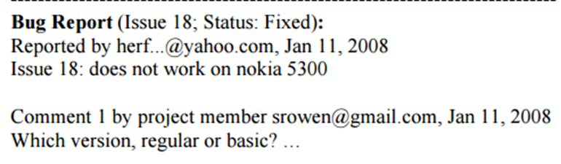
Why Missing Links?
Missing bug reference in change log
Irregular bug reference formats
  “issue 681”, “bug 232”, “fixed for #239”
  Typos: “Fic 239”

Slide 6
Features of Links
To recover the missing links, we studied many bug reports (including comments) and change logs
We have identified the following features of link:
  Time interval: the bug-fix time and change committed time are close
  Bug owner and change committer: they are often the same person, or have mapping relationships
  Text similarity: the textual descriptions in the bug report are often similar to those in the change logs

Slide 7
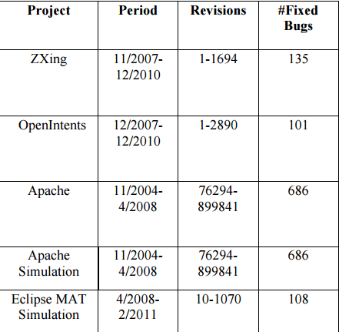
Evaluation Subjects

Slide 8
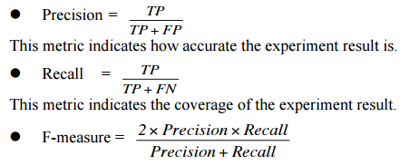
Evaluation Metrics
TP: A link we identify is a true link
FP: A link we identify is not a true link
FN: A link we miss is a true link
TN: A link we miss is not a true link

Slide 9
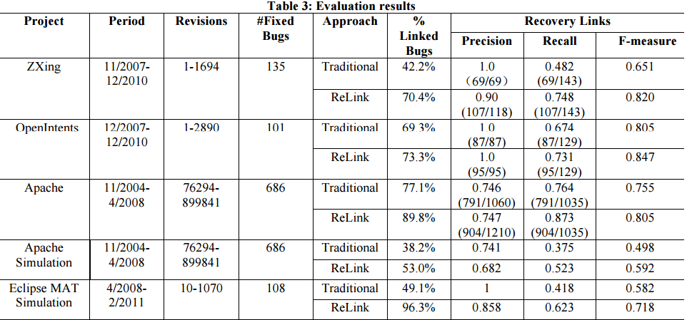
Result

Slide 10
Practical Effects of ReLink 1
What can we do with the recovered links?
  Improving Maintainability Measurement
    The percentage of bug-fixing changes
    The percentage of buggy files
    Mean time to fix
  Constructing better software defect prediction models

Slide 11
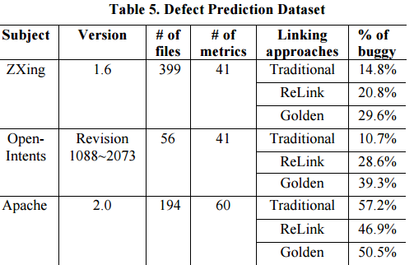
Practical Effects of ReLink 2

Slide 12
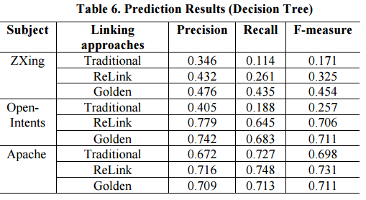
Practical Effects of ReLink 3

Slide 13
Threats to Validity
The quality of golden set of links can’t be completely assured
All the datasets are collected from open source projects
The approach needs to be verified in more projects

Slide 14
Summary
We propose Relink to recover the missing links
The recovered links have positive impact on the follow-up software maintenance studies including defect prediction and maintainability measurement
Future work:
  Further improving the performance of ReLink
  Applying to more projects including industrial projects

