Slide 1

An Analysis of Committers toward Improving the Patch Review Process in OSS development
Shoji Fujita, Masao Ohira, Akinori Ihara, Ken-ichi Matsumoto
Graduate School of Information Science
Nara Institute of Science and Technology, JAPAN
Notes:
My name is Shoji Fujita. I am a master course student at Nara Institute of Science and Technology in Japan.
My presentation is about “An Analysis of Committers toward Improving the Patch Review Process in OSS development”

Slide 2
Introduction
Open Source Software (OSS) became important for the modern society
  OSS developers are expected to fix bugs as soon as possible
Bug modification is conducted through the patch review process, but some OSS projects receive a large number of bug reports on a daily basis[1]
Improvement of patch review process is required
[1] Hailpern B., Santhanam P.: Software debugging, testing, and verification, IBM Systems journal, pp.4-12, 2002.
Notes:
In recent years, Open Source Software became important for the modern society.
As OSS became important, OSS developers are expected to fix bugs as soon as possible.
In OSS development, bug modification is conducted through the patch review process, but some OSS projects receive a large number of bug reports on a daily basis.
As the number of bug reports increases, some bugs are neglected by developers.
So improvement of patch review process is required.

Slide 3


Patch Review Process in OSS
Create
Edit
Developer
Submission
Feedback
Submission
Feedback
Review
Review
Committer
Commit
Commit
Source code repository
  ① Create and submit a patch
  ② Review a submitted patch
  ③ Commit the patch to the source code repository or
  Give feedback to the developer who submitted the patch
  ④ Edit and re-submit a patch
Notes:
Now I will explain the patch review process in OSS development.
This figure shows the patch review process.
The horizontal axis shows the time line.
In this research, “committers” are the developers who have commit permission to the source code repository.
Firstly, a developer creates and submits a patch for fixing bugs.
Secondly, one or more developers review the patch submitted by a developer.
Thirdly, when the correctness of the patch is confirmed, a committer will commit the patch to the source code repository.
When the patch is judged as not appropriate, a reviewer gives feedback to the developer who submitted the patch.
With the given feedback, a developer may often edit and re-submit a patch.

Slide 4
Patch Review Process in OSS
PRT
PET
PRT
Create
Edit
Developer
Submission
Feedback
Submission
Feedback
Review
Review
Committer
Commit
Commit
Source code repository
Patch Review Time (PRT)
The time from patch submitted to patch confirmed or feedback given
Patch Edit Time (PET)
The time from feedback given to edited patch re-submitted
Notes:
At this time,
We define patch review time (PRT) as the time from patch submitted to patch confirmed or feedback given.
Patch edit time (PET) as the time from feedback given to edited patch re-submitted.
This figure only shows the example of one developer submitting a patch and one committer reviewing, but the present situation of the OSS patch review process is…

Slide 5

Problem in Patch Review Process
PRT
PET
Create
Edit
Developer
Submission
Feedback
Submission
Review
Committer
Prolonged review time
Commit
Source code repository
Committers
Developers
Source code repository
Notes:
Like this figure shown at the bottom.
Because of a large number of bug reports, many developers submit many patches to fix bugs
If there exists only a small number of committers who review and commit patches, they cannot react with the patches and end with prolonged review time.
At this time, if we are able to find a developer who is reliable to the OSS project, we can give the developer a commit permission and…

Slide 6
Problem in Patch Review Process
PRT
PET
PRT
Create
Edit
Developer
Submission
Feedback
Submission
Feedback
Review
Review
Committer
Commit
Commit
Reduction of review time
Source code repository
Committers
Developers
Source code repository
Notes:
It may reduce the review time or…

Slide 7
Problem in Patch Review Process
Create
Developer
Skip the review process
Commit
Committer
Important to find a reliable developer as a committer
Source code repository
Committers have huge impact to OSS
Committers
Developers
Source code repository
Notes:
If committers create a patch, they can directly commit to the source code repository and it will skip the review process.
However, committers have a huge impact to OSS project, so we have to carefully choose developers to give a commit permission.
For this reason, it is important to find a reliable developer as a committer.

Slide 8
Goal and Approach
Goal
  Improve the patch review process
Approach
  Select an appropriate developer as a committer
RQ1 : Time
Is there any difference of PRT and PET between committers and non-committers?
RQ2 : Frequency
Is there any difference in the number of patch reviews and patch edits between committers and non-committers?
RQ3 : Type of committers
Is there any difference in performance between committers in the patch review process?
Notes:
Now I will explain the goal and approach of this research
Goal of this research is to improve the patch review process in OSS development.
To achieve the goal, we select an appropriate developer as a committer.
We answer the following Research Questions to reveal indicators for selecting a committer.
RQ1 is about the time.
Is there any difference of PRT and PET between committers and non-committers?
RQ2 is about the frequency.
Is there any difference in the number of patch reviews and patch edits between committers and non-committers?
RQ3 is about the type of committers.
Is there any difference in performance between committers in the patch review process?

Slide 9
Analysis Method
Investigate the time and frequency for the patch review process
  RQ1 : Patch Review Time (PRT) and Patch Edit Time (PET)
    Compare committers and non-committers
  RQ2 : Number of Patch Reviews (NPR) and Number of Patch Edits (NPE)
    Compare committers and non-committers
  RQ3：Performance between committers
    Classify committers by all developers median
Notes:
Now I will explain the analysis method.
To answer the 3 Research Questions we investigated the time and frequency for the patch review process of the committers and non-committers.
For RQ1 we compare committers and non-committers to see if there is any difference.
For RQ2 we define the number of patch reviews as NPR and the number of patch edits as NPE
And then compare committers and non-committers to see if there is any difference.
For RQ3, we classify committers by all developers’ median PRT, PET, NPR and NPE.

Slide 10

Case Study
OSS project
  PostgreSQL
Target Data
  ML archives (pgsql-hackers, pgsql-patches)
Analysis Period
  2001/01～2008/12 (8years)
 | Frequency | Committers | Non-Committers
Patch Review | 3352 | 14 | 200
Patch Edit | 1848 | 14 | 132
Notes:
We conducted a case study on PostgreSQL project.
The target data is ML archives that developers submit patches to.
The analysis period is from 2001 to 2008.
The number of patch reviews is 3352, 14 committers and 200 non-committers are involved to patch review.
The number of patch edits is 1848, 14 committers and 132 non-committers are involved to patch edit.

Slide 11
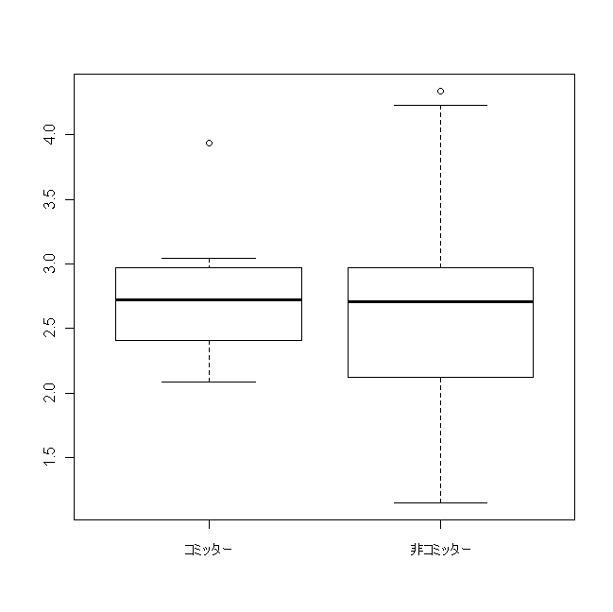
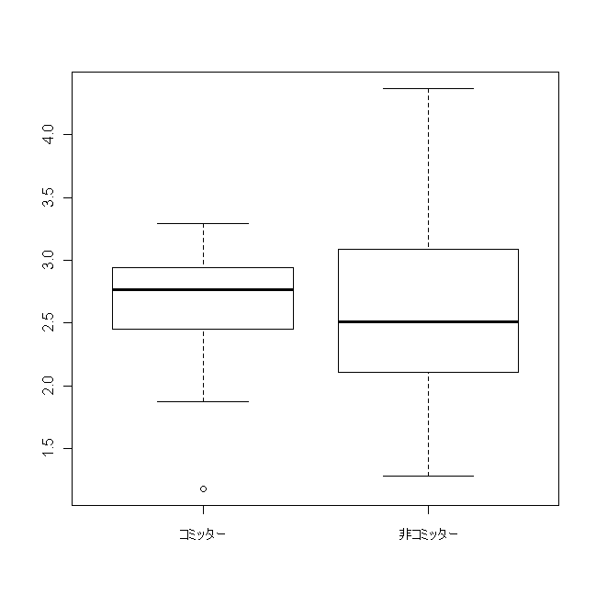
RQ1 : Developers’ PRT and PET
  PRT PET
10000
1000
100
10000
1000
100
PRT (minutes)
PET (minutes)
Committers Non-Committers
Committers Non-Committers
p-value : 0.65(>0.05)
p-value : 0.48(>0.05)
No big difference between committers and non-committers
PRT and PET cannot be the indicator for selecting a committer
Notes:
Now I would like to explain the results.
At first, I investigated developers’ PRT and PET.
The left figure shows the distribution of committers and non-committers’ PRT.
The vertical axis shows the PRT in minutes.
The right figure shows the distribution of committers and non-committers’ PET.
The vertical axis shows the PET in minutes.
From the results, there is no big difference of PRT and PET between committers and non-committers.
Also there were no significant difference, PRT and PET cannot be the indicator for selecting a committer.

Slide 12
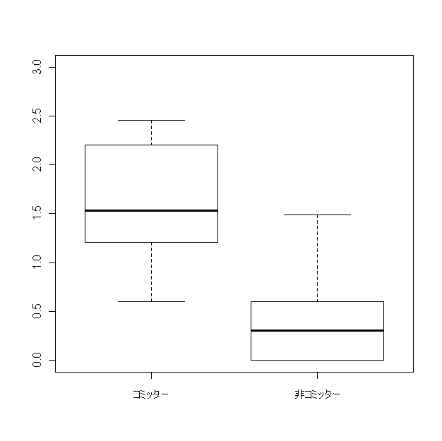
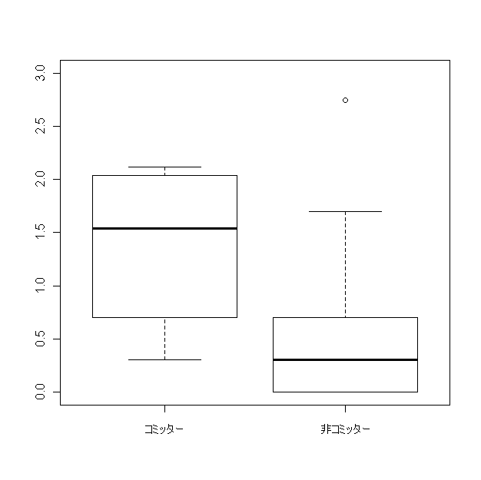
RQ2 : Developers’ NPR and NPE
  NPR NPE
1000
100
10
1
1000
100
10
1
NPR
NPE
Committers Non-Committers
Committers Non-Committers
p-value : 0.00(<0.05)
p-value : 0.00(<0.05)
Significant difference between committers and non-committers
Number of patch reviews and edits can be one of the indicators for selecting a committer
There are some non-committers who show high performance of patch editing as committers
Notes:
For RQ2, we investigated developers’ NPR and NPE
.
The left figure shows the distribution of committers and non-committers’ NPR.
The vertical axis shows the NPR.
The right figure shows the distribution of committers and non-committers’ NPE.
The vertical axis shows the NPE.
From the results, committers have higher NPR and NPE than non-committers.
Also there is a significant difference between committers and non-committers, NPR and NPE can be the indicator for selecting a committer.
With this point of view, please look at the right figure, there are some non-committers in the red circle show high performance of patch editing as committers.

Slide 13
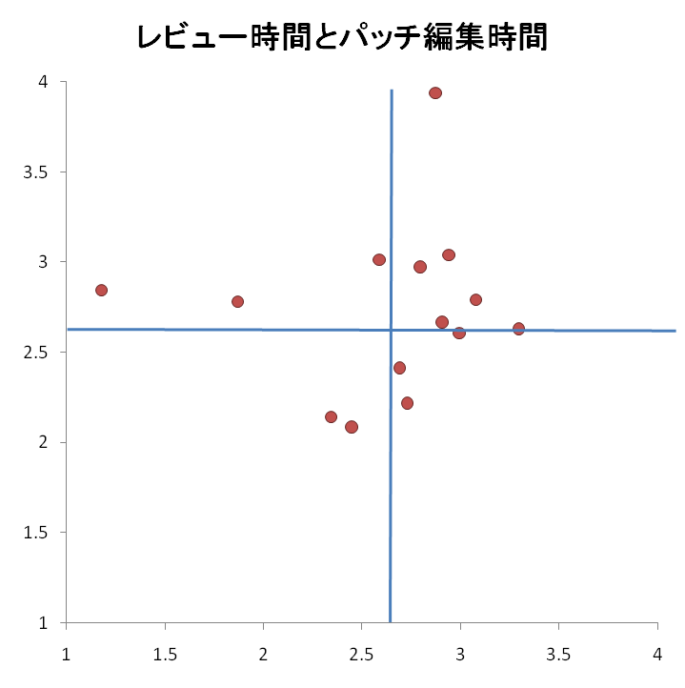
RQ3 : Committers’ performance
Time | PRT and PET
Patch Review | PRT and NPR
Patch Edit | PET and NPE
Frequency | NPR and NPE
PRT and PET
10000
1000
100
10
PRT (minutes)
10 100 1000 10000
PET (minutes)
Committers spread into all four classified categories
Notes:
For RQ3, we investigated the committers’ performance.
At first, we focused about the time in patch review process.
This figure shows committers’ PRT and PET.
The horizontal axis shows the PET in minutes and the vertical axis shows the PRT in minutes.
Each red dots represents one committer.
Each horizontal and vertical blue lines show the median PRT and PET for all developers (including committers and non-committers)
From this figure,
Committers spread into all four classified categories.

Slide 14
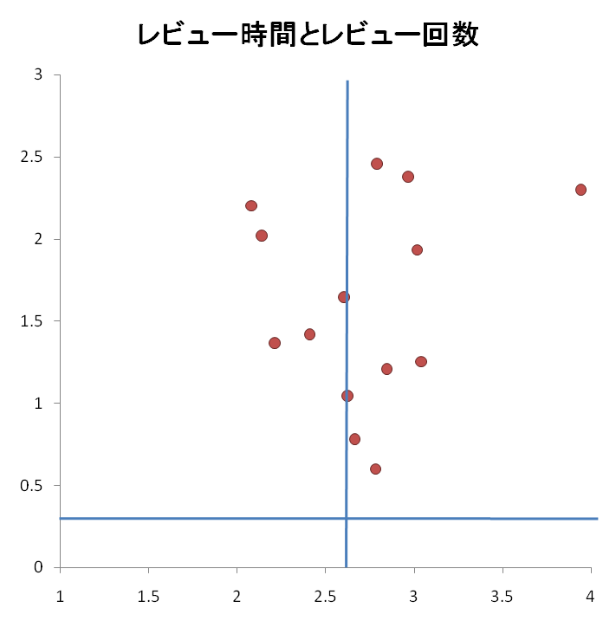
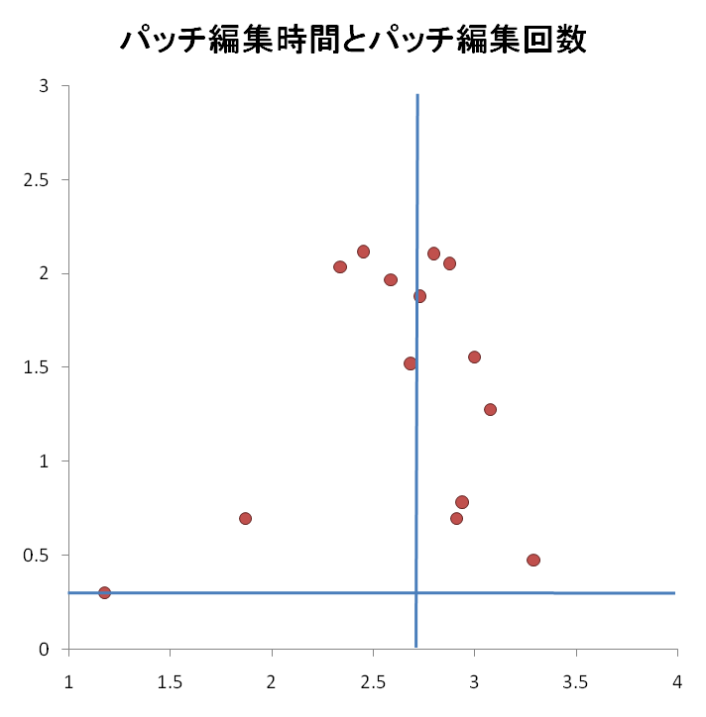
RQ3 : Committers’ performance
Time | PRT and PET
Patch Review | PRT and NPR
Patch Edit | PET and NPE
Frequency | NPR and NPE
PRT and NPR
PET and NPE
1000
100
10
1
1000
100
10
1
NPR
NPE
10 100 1000 10000
10 100 1000 10000
PRT (minutes)
PET (minutes)
For PRT and PET, committers divided into both longer and shorter categories
Time cannot be the indicator for selecting a committer
Notes:
Next we investigated the relationship between PRT and NPR, PET and NPE.
The left figure shows committers PRT and NPR, the right figure shows committers’ PET and NPE.
From these figures, we can say the same thing as the previous slide.
So the time for patch review process cannot be the indicator for selecting a committer.

Slide 15
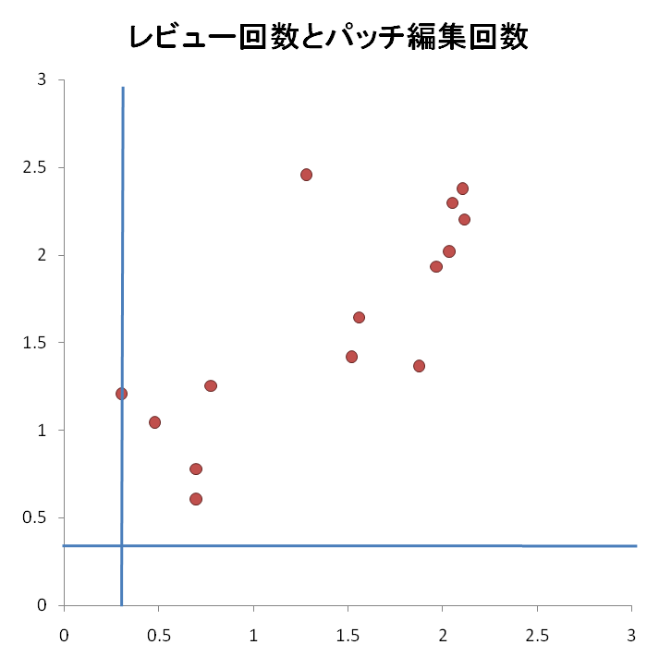
RQ3 : Committers’ performance
Time | PRT and PET
Patch Review | PRT and NPR
Patch Edit | PET and NPE
Frequency | NPR and NPE
NPR and NPE
1000
100
10
1
Coefficient of correlation: 0.77
NPR
1 10 100 1000
NPE
All committers’ NPR and NPE are higher than the median
Developers who have higher NPR and NPE than median can be the candidate for committers
Notes:
Finally, we investigated the relationship between committers’ NPR and NPE. This figure shows the results.
From the results all committers have higher NPR and NPE than the median.
Also the coefficient of correlation between NPR and NPE was 0.77.
Therefore developers who have higher NPR and NPE than median can be the candidate for committers.

Slide 16
Additional Research Question
The statement “committers have higher NPR and NPE than non-committers” seems to be too NORMAL
  Because committers are more likely to participate longer than non-committers
We have to look at the contributions per specific time
Notes:
However, as this paper’s reviewer pointed that
the statement “committers have higher NPR and NPE than non-committers” seems to be too normal.
This is because committers are more likely to participate longer than non-committers.
So we have to look at the contributions per specific time.

Slide 17
Additional Research Question
RQ4 : Frequency per specific period
Is there any difference in the average NPR and NPE per month between committers and non-committers?
We collected the data as follows
  Average NPR per month (NPRave)
    NPRave = NPR / t
  Average NPE per month (NPEave)
    NPEave = NPR / t
t indicates the participation period in months
Notes:
Now we have conducted another analysis to answer additional Research Question.
Which is RQ4;
“Is there any difference in the average NPR and NPE per month between committers and non-committers?”
We collected the average number of patch reviews and edits per month as these equations.
Where t indicates the participation period in months when the developer did patch review or edit at lease one time.

Slide 18
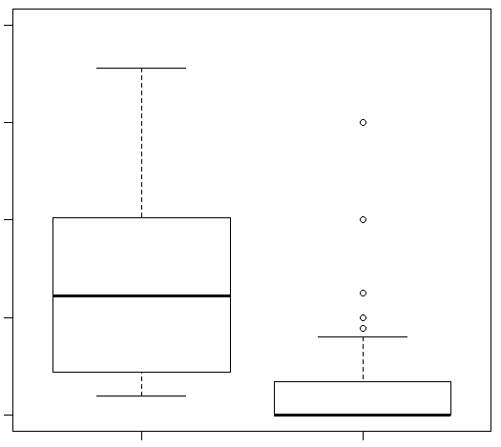
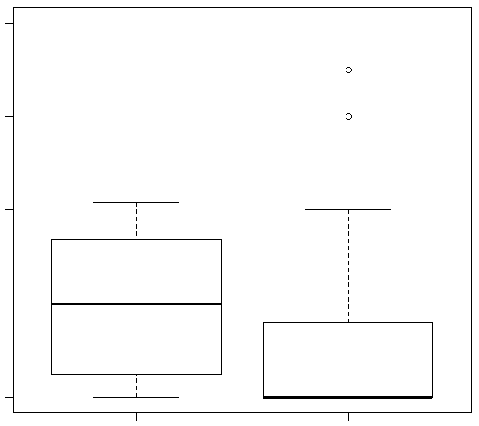
RQ4 : Developers’ average NPR and NPE per month
  Average NPR per month Average NPE per month
5
4
3
2
1
5
4
3
2
1
NPRave
NPEave
p-value : 0.00(<0.05)
Committers Non-Committers
Committers Non-Committers
p-value : 0.00(<0.05)
p-value : 0.00(<0.05)
Significant difference between committers and non-committers
Developer who works many times in patch review process per specific time period tend to be a committer
Notes:
These are the results of RQ4, distribution of developers’ average NPR and NPE per month.
The left figure shows the average NPR per month and the right figure shows the average NPE per month.
From the results committers tend to have higher average of NPR and NPE per month than non-committers and there is a significant difference between committers and non-committers.
Therefore developer who works many times in the patch review process per specific period tend to be a committer.

Slide 19
Conclusions and Future Work
Conclusions
  We analyzed differences in performance between committers and non-committers and found;
    Time cannot be the indicator for selecting a committer
    Frequency can be one of the indicators for selecting a committer
    Developers who have higher NPR and NPE than median can be the candidate for committer
Future Work
  Consider patch quality
    Patch acceptance rate, Number of bugs inserted in a patch
  Analyze committers activity before and after gaining the commit permission
  Generality of the case study
    Conduct more case studies on multiple types of OSS
Notes:
Conclusions
We analyzed differences in performance between committers and non-committers and found;
Time cannot be the indicator for selecting a committer
Frequency can be one of the indicators for selecting a committer
Developers who have higher NPR and NPE than median can be the candidate for committer
For our Future Work, we have to
Consider patch quality which can be the Patch acceptance rate, Number of bugs inserted in a patch
We also want to Analyze committers activity before and after gaining the commit permission
Finally at the present time, we only conducted one case study of PostgreSQL project,
We should conduct more case studies on multiple types of OSS

Slide 20
Thanks for listening!

Slide 21
appendix

Slide 22
Definition of developers
Developers（do not distinguish committers or not）
  Committers
    ○Review
    ○Edit
      Able to commit directly to the source code repository
  Non-Committers
    △Review
      Not able to commit
    ○Edit

Slide 23

Analysis Method
Collecting Data
  PRT, NPR, PET and NPE
mail01 [From : A] :______________
patch01.c
PRT
mail02[From : B] : Re:______________
PET
PRT
PET
mail03 [From : A] : Re: Re:______________
patch02.c
mail04 [From : C] : Re:______________
mail05 [From : D] : Re:______________
patch03.c
Submit Message Information |  |  | Reply Message Information |  |  | Time | Action
ID | Submit time | Name | ID | Reply time | Name | (minutes)
mail01 | 2010/4/20 9:55 | A | mail02 | 2010/4/20 13:18 | B | 203 | Review
mail02 | 2010/4/20 13:18 | B | Mail03 | 2010/4/20 15:53 | A | 155 | Edit
mail01 | 2010/4/20 9:55 | A | mail04 | 2010/4/20 21:40 | C | 705 | Review
mail01 | 2010/4/20 9:55 | A | mail05 | 2010/4/21 2:38 | D | 1003 | Edit

Slide 24
Statistics
PRT | All developers | Non-committers | Committers
# Developers*1 | 64 | 50 | 14
Median | 507.50(2.71) | 507.50(2.70) | 533.00(2.72)
Average | 1479.07(3.17) | 1579.25(3.20) | 1121.29(3.05)
Standard dev | 3572.63(3.55) | 3875.23(3.59) | 2132.97(3.33)
PET | All developers | Non-committers | Committers
# Developers*2 | 50 | 36 | 14
Median | 411.00(2.61) | 324.50(2.51) | 583.00(2.77)
Average | 1188.88(3.07) | 1394.47(3.14) | 660.21(2.82)
Standard dev | 3317.03(3.52) | 3877.61(3.59) | 493.46(2.69)
NPR | All developers | Non-committers | Committers
# Developers | 214 | 200 | 14
Median | 2.00(0.30) | 1.00(0.00) | 35.00(1.54)
Average | 15.55(1.19) | 10.56(1.02) | 86.93(1.94)
Standard dev | 100.93(2.00) | 99.65(1.99) | 91.79(1.96)
NPE | All developers | Non-committers | Committers
# Developers | 146 | 132 | 14
Median | 2.00(0.30) | 1.00(0.00) | 34.50(1.54)
Average | 12.62(1.10) | 8.24(0.92) | 53.93(1.73)
Standard dev | 50.24(1.70) | 48.33(1.68) | 49.18(1.69)
＊1 Developers with 5 or more patch reviews
＊2 Developers with 5 or more patch edits

