Slide 1
How Modern News Aggregators Help Development Communities Shape and Share Knowledge
(最新のニュースアグリゲーターが開発コミュニティの知識の形成と共有にどのように役立つか)
Mauricio Aniche, Christoph Treude, Igor Steinmacher, Igor Wiese, Gustavo Pinto, Margaret-Anne Storey, Marco Aurelio Gerosa

Slide 2
BACKGROUND
Software developers need awareness of the latest news related to their profession
News channels play an important role in knowledge exchange
These modern news aggregators offer a blend of gamification and social network features that
  Increases developer social capital in a community
  Enables faster dissemination of curated content
  Such as Hacker News and Reddit
Up to now, there have only been a small number of studies of news aggregators for software developers
There is little understanding of on news aggregators
A study to understand more about modern news aggregators
Used Reddit and Hacker News aggregators in this study
  enable users to post links with a short description and support commenting as well as voting on posts and comments
Notes:
To succeed in today’s fast-paced and ever-changing work environment with new technologies and devices being constantly introduced, software developers need awareness of the latest news related to their profession
News channels play an important role in knowledge exchange
These modern news aggregators, such as Hacker News and Reddit, offer a blend of gamification and social network features that increases developer social capital in a community and enables faster dissemination of curated content.
there is little understanding of how news aggregators play a role in community curation and dissemination of knowledge
Up to now, there have only been a small number of studies of news aggregators for software developers.
In this paper, we present a study to understand how modern news aggregators, i.e., those that incorporate gamification and social network features, are used by software developers to curate and disseminate knowledge. We consider the popular and widely recommended Reddit and Hacker News aggregators in our study. These aggregators enable users to post links with a short description and support commenting as well as voting on posts and comments.

Slide 3
AIM
To understand programming-related news aggregator (r/programming and Hacker News)
Notes:
In this paper, we present a study to understand how modern news aggregators, i.e., those that incorporate gamification and social network features, are used by software developers to curate and disseminate knowledge. We consider the popular and widely recommended Reddit and Hacker News aggregators in our study. These aggregators enable users to post links with a short description and support commenting as well as voting on posts and comments.

Slide 4
RESEARCH QUESTIONS
RQ1: What motivates developers to participate in programming-related news aggregators?
RQ2: What are the characteristics of the content posted in programming-related news aggregators?
RQ3: What suggestions do the participants have to improve the community and features of programming-related news aggregators?
Notes:
RQ1: What motivates developers to participate in programming-related news aggregators?
RQ2: What are the characteristics of the content posted in programming-related news aggregators?
RQ3: What suggestions do the participants have to improve the community and features of programming-related news aggregators?

Slide 5
METHOD
Interviews
Survey
Content analysis

Slide 6
INTERVIEWS
Recruited active members of the r/programming community for the interviews
Interviewed 22 participants (response rate of 10%), identified as P1 - P22
  All participants work in the software development industry
  Their experience in industry ranges from 3 to 25 years
  Interviewees belong to different ethnic groups (living in South America, North America, Europe, Asia, and Oceania)
  Together, they speak 12 different languages
Interviews were conducted via video calls and e-mail
Focused on five main topics:
(1) The interviewees’ perceptions about what motivates them to use the news aggregator
(2) Reasons to contribute (i.e., posting news, commenting, and voting)
(3) The content they commonly read and what the learning outcomes are
(4) The differences among news aggregators(e.g., Reddit, Hacker News)
(5) Pitfalls and challenges they face, as well as advice for newcomers
Notes:
recruited active members of the r/programming community for the interviews.
ordered participants by their number of posts according to our dataset
and sent a private message to the 229 most active r/programming contributors in terms of number of posts.
interviewed 22 participants (response rate of 10%), identified as P1 - P22.
All participants work in the software development industry.
While most are developers, two are marketing specialists (P8, P20) and two are Computer Science students (P11, P12).
Their experience in industry ranges from 3 to 25 years.
Interviewees belong to different ethnic groups (living in South America, North America, Europe, Asia, and Oceania).
Together, they speak 12 different languages.
Table 1 shows participant demographics.
18 interviews were conducted via video calls and four interviews were conducted via e-mail (as requested by the participants)
focused on five main topics:
(1) the interviewees’ perceptions about what motivates them to use the news aggregator
(2) reasons to contribute (i.e., posting news, commenting, and voting)
(3) the content they commonly read and what the learning outcomes are
(4) the differences among news aggregators(e.g., Reddit, Hacker News)
(5) pitfalls and challenges they face, as well as advice for newcomers

Slide 7
SURVEY
Aimed at measuring the qualitative findings
Had to indicate their agreement with statements derived from the interview analysis
Answer options ranged from strongly disagree to strongly agree
  Also allowed users to respond "do not know" or "does not apply"
The survey contained 21 statements and demographics questions
Shared the survey on five social networks: Medium, Hacker News, Reddit, Twitter, and Facebook
Obtained 99 answers
Were from 32 different countries
All participants are involved with software development activities
Notes:
aimed at triangulating the qualitative findings.
Respondents had to indicate their agreement with statements derived from the interview analysis, which represented codes that not all of our interview participants agreed on.
Answer options ranged from strongly disagree to strongly agree, in a 5-points Likert scale with a neutral option; we also allowed users to respond "do not know" or "does not apply".
The survey contained 21 statements (see Figures 1 and 2) and demographics questions. The estimated time to answer our survey was four minutes.
shared the survey on five social networks: Medium, Hacker News, Reddit, Twitter, and Facebook.
Due to the nature of these websites, we are not able to estimate how many users we sent it to.
obtained 99 answers (3 from Medium, 5 from Facebook, 36 from Twitter, 21 from Hacker News, and 34 from Reddit).
These 99 participants were from 32 different countries.
Respondents vary regarding how long they have been using news aggregators (min=0 years, q1=1.5 years, median=3 years, q3=6 years, max=15 years).
34.3% of the participants visit such websites at least once a day, and another 30.3% between once a day and once a week; only 5.1% indicated that they visit news aggregators less than once a month.
All participants are involved with software development activities

Slide 8
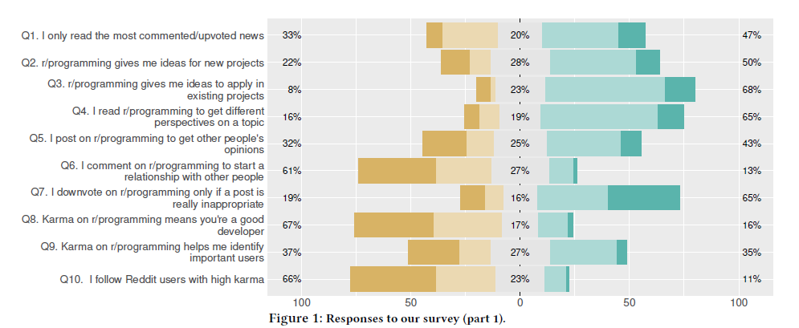
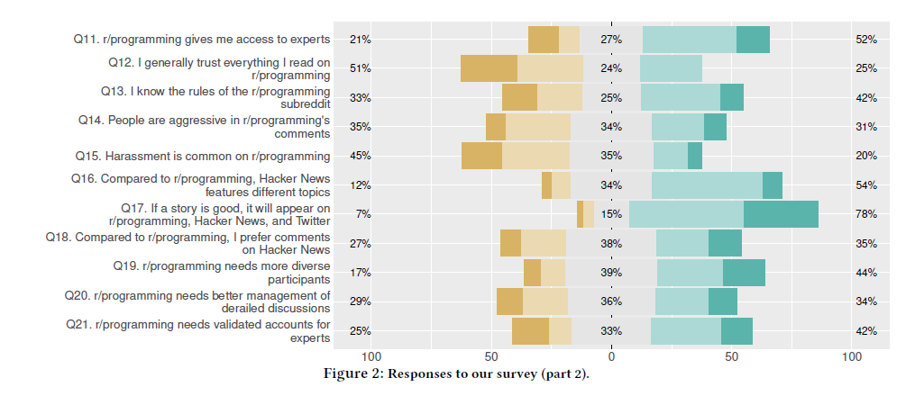

Slide 9
CONTENT ANALYSIS
Collected all posts and comments posted between 1 January 2016 and 30 April 2017
  492,752 posts from Hacker News
  44,640 posts from r/programming
Randomly selected a sample of
  300 posts from Reddit’s r/programming
  300 posts from Hacker News
Notes:
collected all posts and comments on Hacker News and r/programming posted between 01 January 2016 and 30 April 2017
gathered 492,752 posts from Hacker News and 44,640 posts from r/programming.
understand the content posted on the selected news aggregators, randomly selected a sample of 300 posts from Reddit’s r/programming and 300 posts from Hacker News, which gives our conclusions a confidence level of 95% with a margin of error of 6%

Slide 10
RESULT
Motivations to participate (RQ1)
Characteristics of the content (RQ2)
Improving the community (RQ3)

Slide 11
1. Motivations to participate (RQ1)
Participants reported motivations to post, comment, vote, and read
Motivations to post
Motivations to comment
Motivations to vote
Motivations to read
Impact of the news aggregators

Slide 12
MOTIVATIONS TO POST
Main reasons for participants to post
  Self-promoting own work
  Sharing relevant content
Other reasons:
  Promote their own work to get feedback and possibly improve the content created
  To share third-party content that might be interesting to others
  Part of their jobs as community members
  Shared with the goal of discussing the topic
  Gamification also may play a role
Notes:
two main reasons for participants to post links on programming-related news aggregators:
self-promoting own work and sharing relevant content
--promote their own work to get feedback and possibly improve the content created
--to share third-party content that might be interesting to others
--part of their jobs as community members
--shared with the goal of discussing the topic
--Gamification also may play a role

Slide 13
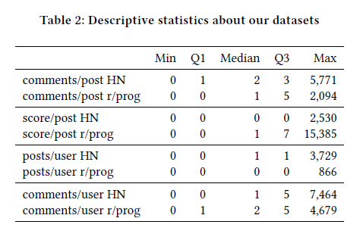
MOTIVATIONS TO COMMENT
Median number of comments per user
  1 on Hacker News (q1=0; q3=5)
  2 on r/programming (q1=1; q3=5)
Have something that they consider useful to add
To start a conversation
Notes:
median number of comments per user
2 on r/programming (q1=1; q3=5)
1 on Hacker News (q1=0; q3=5)
have something that they consider useful to add
to start a conversation

Slide 14
MOTIVATIONS TO VOTE
Main reasons to upvote:
  Upvote posts that they consider interesting
  See voting as a way to filter good posts so that other people find them
Other reasons:
  To see more comments and discussion
  To make readers learn something new
  To have a more complete profile
  To bookmark a post for later
  Agree with a comment
  Make a good point(for posts or comments that go against their beliefs )
Downvoting is not seen as a common activity, as it may be seen as demotivating
  When a post or a comment is inappropriate, off-topic, offensive, impolite, or spam
Notes:
Main reasons to upvote:
Upvote posts that they consider interesting
See voting as a way to filter good posts so that other people find them
Downvoting is not seen as a common activity, as it may be seen as demotivating
When a post or a comment is inappropriate, off-topic, offensive, impolite, or spam

Slide 15
MOTIVATIONS TO READ
Main reasons:
  Provide relevant content
  Make them aware of the trending topics
Other reasons:
  To get up-to-date with technologies
  As a source of ideas for future books, blog posts, and products
  Also for the discussion that may happen
Notes:
Main reasons:
programming-related news aggregators provide relevant content
make them aware of the trending topics
47% of the survey -read only the most upvoted comments and posts
33% also read non-popular posts
Other reasons:
to get up-to-date with technologies
as a source of ideas for future books, blog posts, and products
50% of our survey respondents use news aggregators as a source for new projects, and 68% affirmed the posts give them ideas to apply in their existing projects
also for the discussion that may happen

Slide 16
IMPACT OF THE NEWS AGGREGATORS
News aggregators impact on lives of the participants
Valuable marketplaces with good ideas that developers can take advantage of
Also afforded our participants different opportunities
To evaluate new technologies at work
To try technologies they had never tried before
To see how other developers are building software and learn from their experience
To ask for help
To be part of a bigger community
Enable people to meet experts from many different fields
Notes:
1)because of the aggregators’ smooth information flow, they become valuable marketplaces with good ideas that developers can take advantage of
2)also afforded our participants different opportunities, such as ideas and technologies to learn (P3, P9, P15, P22),
3)to evaluate new technologies at work (P7),
4)to try technologies they had never tried before (P18),
5)to see how other developers are building software and learn from their experience (P15),
6)to ask for help (P20),
7)to be part of a bigger community
8)enable people to meet experts from many different fields.
52% of them agreed that r/programming gives them
access to experts; only 21% did not agree (Figure 2, Q11).

Slide 17
2. Characteristics of the content (RQ2)
Characteristics of the content
Overlap and differences
Content reliability

Slide 18
CHARACTERISTICS OF THE CONTENT
a)PURPOSE
r/programming:
  Aiming at learning
  Publicizing software
Hacker News
  Publicizing news
  Announcements of new software versions
  Asking for feedback, help, and questions
  Sharing opinions
Other posts that:
  Advertising products and services
  Sharing collections
  Threat alerts
  Humor
Notes:
PURPOSE
Posts aiming at learning are more common on r/programming (r/p: 45%; HN: 18%), while publicizing news is more common on Hacker News (r/p: 6%; HN: 29%).
--Hacker News, some news are published in scientific venues (r/p: 0%; HN: 10%).
Publicizing software, such as libraries, tools, and toy projects, is more common on r/programming (r/p: 19%; HN: 7%), while announcements of new software versions are more common on Hacker News (r/p: 3%; HN: 7%).
--Asking for feedback, help, and questions (r/p: 2%; HN: 6%) and sharing opinions (r/p: 6%; HN: 12%) are also more common on Hacker News.
--advertising products and services (r/p: 3%; HN: 1%), sharing collections (r/p: 3%; HN: 3%), threat alerts (r/p: 2%; HN: 2%), and humor (r/p: 2%; HN: 1%)
Common styles of the learning posts are tutorials (r/p: 31%; HN: 17%), specific tips (r/p: 10%; HN: 18%), tech reviews (r/p: 10%; HN: 2%), experience reports (r/p: 7%; HN: 11%), conference talks (r/p: 7%; HN: 2%), screen casts(r/p: 7%; HN: 2%), books (r/p: 2%; HN: 2%), and code explanations(r/p: 2%; HN: 0%).
These results confirm some motivations brought by our interviewees, who mentioned that Reddit brings opportunities to experiment and learn new technologies.

Slide 19
CHARACTERISTICS OF THE CONTENT
b) THEME
r/programming
  88% of posts being IT-related
  74% focused on development, 15% on technology in general, 6% on security, and 4% on artificial intelligence
On Hacker News
  55% of posts being IT-related
  48% of them focusing on development, 36% on technology in general, 10% on security, and 7% on artificial intelligence
Notes:
THEME
on r/programming, as expected, most posts have an IT-related theme (88% of the posts) and of those, 74% focused on development, 15% on technology in general, 6% on security, and 4% on artificial intelligence.
On Hacker News, posts are more diverse, with only 55% of posts being IT-related (48% of them focusing on development, 36% on technology in general, 10% on security, and 7% on artificial intelligence).
--For posts that are not related to IT, job market was the most mentioned theme in r/programming (4% of all posts). On Hacker News, the scope is broader, with some focus on business (12%) and society-related (e.g., religion, living costs, immigration) content (9.6%), including themes such as startups (4%), politics (3.6%), and science (3.3%).

Slide 20
CHARACTERISTICS OF THE CONTENT
c) TECHNOLOGY
Related to similar topics
  Programming/Markup Languages appearing as the most mentioned technologies
  JavaScript (7.3%) and Java (6.9%) are the most common, followed by C++ (4.8%), Python (4.8%), C (4.4%), and React (3.6%)
d) DEVELOPMENT ACTIVITY
Classified according to the development activity they are related to
Most of them are related to
  Programming activities
  DevOps
  Configuration management
  Testing
  Design/architecture
Notes:
TECHNOLOGY
r/programming and Hacker News posts are related to similar topics
Programming/Markup Languages appearing as the most mentioned technologies
JavaScript (7.3%) and Java (6.9%) are the most common, followed by C++ (4.8%), Python (4.8%), C (4.4%), and React (3.6%).
DEVELOPMENT ACTIVITY
classified according to the development activity they are related to
most of them are related to
programming activities (r/p: 72%; HN: 59%)
DevOps (r/p: 13%; HN: 14%)
configuration management (r/p: 4%; HN: 3%)
testing (r/p: 4%; HN: 5%)
design/architecture (r/p: 2%; HN: 2%).

Slide 21
CHARACTERISTICS OF THE CONTENT
e) SOURCE
Blog posts (r/p: 47%; HN: 36%) are the most frequent type of source
  Majority: personal blogs (r/p: 88%; HN: 87%)
  Companies’ official blog posts (r/p: 12%; HN: 13%) - only a small proportion
Hacker News - news websites
r/programming - software project home pages or repositories
Other common sources:
  Static web pages
  Other aggregator posts
  YouTube videos
  Q&A sites
  Wikipedia pages, online courses, crowdfunding platforms, Twitter posts, pictures, online tools, and other subreddits, among others
Notes:
SOURCE
Blog posts (r/p: 47%; HN: 36%) are the most frequent type of source for both aggregators. But only a small proportion of these posts refer to companies’ official blog posts (r/p: 12%; HN: 13%) as the majority are from personal blogs (r/p: 88%; HN: 87%).
--News websites are common for Hacker News (r/p: 4%; HN: 22%), and software project home pages or repositories are more common for r/programming (r/p: 12%; HN: 6%).
Most of these home pages are hosted on GitHub (r/p: 86%; HN: 68%).
Other common sources are static web pages (r/p:14%; HN: 15%),
other aggregator posts (r/p: 1%; HN: 8%),
YouTube videos (r/p: 6%; HN: 3%),
and Q&A sites (r/p: 2%; HN: 0%).
We also found (less than 2% each) Wikipedia pages, online courses, crowdfunding platforms, Twitter posts, pictures, online tools, and other subreddits, among others.
--Medium.com, appears as the most shared domain on Hacker News (22,017 occurrences - 5.83%) and third most shared in r/programming (2,084 - 4.66%), and traditional newspapers are common in Hacker News (NYTimes=7,396 - 1.92%, bloomberg.com=4,293 - 1.11%, washingtonpost.com=2,249 - 0.58%), whereas in r/programming we found only 64 posts from these three newspapers.

Slide 22
OVERLAP AND DIFERRENCES
Overlap between the two news aggregators differs:
  34% of the posts posted on r/programming were also posted on Hacker News
  5% of the posts posted on Hacker News were also posted on r/programming
Hacker News has more general terms while r/programming is more focused on programming
General topics:
  50% of Hacker News posts
  less than 15% of r/programming posts
54% of our survey respondents agreed -contain different content
Notes:
the overlap between the two news aggregators differs: 34% of the posts posted on r/programming were also posted on Hacker News; 5% of the posts posted on Hacker News were also posted on r/programming.
-hypothesize that this difference happens due to breadth and depth. Since Hacker News favors broader content, few users might be tempted to re-post content on r/programming, which is a depth-oriented news aggregator. Whereas, content posted on r/programming is also suitable for re-posting on Hacker News.
five most frequent words in the titles of posts shared on Hacker News are show (15,663 occurrences - 1,32%), new (13,288 - 1,12%), app (9,283 - 0,78%), google (8,857 - 0,74%), and data (8,841 - 0,74%).
Whereas, the five most frequent words in r/programming are program (3,987 - 2,37%), code (2,977 - 1,77%), develop (2,564 - 1,53%), learn (1,661 - 0,99%), and java (1,624 - 0,96%).
This concurs with our previous finding that Hacker News has more general terms while r/programming is more focused on programming.
--This confirms the results of our qualitative analysis on the content themes, in which we found that around 50% of Hacker News posts are general topics, while they represent less than 15% of r/programming posts.
Additionally, 54% of our survey respondents agreed that Hacker News and Reddit contain different content; however, 78% affirmed that, when the content is good, it will eventually appear in all news aggregators (Figure 2, Q16 and Q17).
--interviewees perceive comments on Hacker News to have better quality than the ones on Reddit

Slide 23
CONTENT RELIABILITY
A known problem in any social network is the number of fake or wrong news
Observed that such a problem is not perceived by the participants
  because technical articles are easier to trust
  bad opinions (and bad code) can be easily identified
  HOWTOs are straightforward
read posts and comments with a grain of salt
None of our survey respondents strongly agreed with the idea of trusting all technical content one can find in r/programming
  25% agreed, 24% were neutral, and 51% disagreed
Notes:
a known problem in any social network is the number of fake or wrong news
observed that such a problem is not perceived by our participants, mostly because technical articles are easier to trust, as bad opinions (and bad code) can be easily identified, and HOWTOs are straightforward as they
only explain how to do something with a specific technology
-Even though they trust technical articles, they also indicate to read posts and comments with a grain of salt
None of our survey respondents strongly agreed with the idea of trusting all technical content one can find in r/programming: 25% agreed, 24% were neutral, and 51% disagreed (Figure 2, Q12).

Slide 24
3. Improving the community (RQ3)
Moderation and code of conduct
New features
The role of karma
Pitfalls and advice

Slide 25
MODERATION AND CODE OF CONDUCT
Suggested different types of moderation
  To avoid users that are always negative
  To police (and punish) bad behavior
  To reduce negative criticism
  To remove posts that are not entirely focused on programming(in case of r/programming)
  The introduction of a code of conduct
Notes:
Participants suggested different types of moderation, such as to avoid users that are always negative (P7),
not to let derailed discussions go to the top of the website (P9),
to police (and punish) bad behavior (P13-14, P18),
to reduce negative criticism (P20), and, in case of r/programming,
to remove posts that are not entirely focused on programming(P19).
P14 suggested the introduction of a code of conduct

Slide 26
NEW FEATURES
News aggregators could provide detailed analytics on their posts as well as on the community as a whole
Other suggestions:
  To provide credentials for experts in different fields
  Add "subreddits" to Hacker News
  Improve the user interface when it comes to showing large discussions
  Promote deeper content with more discussions
  Improve user diversity
The survey participants agreed with most of these suggestions
Notes:
news aggregators could provide detailed analytics on their posts as well as on the community as a whole
Other suggestions:
to provide credentials for experts in different fields
add "subreddits" to Hacker News
improve the user interface when it comes to showing large discussions
promote deeper content with more discussions
improve user diversity
The survey participants agreed with most of these suggestions: 44% agreed that r/programming needs more participant diversity, 34% agreed on the need for better management of derailed discussions, and 42% would benefit from having validated credentials for experts

Slide 27
ROLE OF KARMA
For many, karma is not the main reason they post on r/programming
Indirect effects of karma :
  A motivating factor for users to participate
  Users respect other users with high karma
  Serves as a measurement of how good or interesting that link really is
  To track relevant users
  To track what posts attract more attention
  To be able to create a new subreddit (which requires an undisclosed amount of karma points)
Survey respondents do not tend to follow users with high karma(only 11% do so)
Notes:
For many, karma is not the main reason they post on r/programming
indirect effects of karma :
a motivating factor for users to participate
users respect other users with high karma
serves as a measurement of how good or interesting that link really is
to track relevant users
to track what posts attract more attention
to be able to create a new subreddit (which requires an undisclosed amount of karma points)
67% of survey respondents did not believe that users with high karma are necessarily good developers. On the other hand, 35% of them saw karma as a way to identify relevant users. However, our respondents do not tend to follow users with high karma, as only 11% do so (Figure 1, Q8, Q9, and 10).

Slide 28
PITFALLS AND ADVICE
Most participants advised
  Should not engage with trolls
  To avoid being part of flame wars
  Participants should be positive and always pose opinions constructively
  Watch for new trends
  Avoid click baits
  Read the comments of a good post
  Post the primary source of the content
  Be critical when applying something elsewhere
  Look for the right sub-community to follow and post
  Should know the rules of their news aggregator
Notes:
Most participants advised
Should not engage with trolls
To avoid being part of flame wars
When participating in discussions, participants should be positive and always pose opinions constructively
Watch for new trends
Avoid click baits
Read the comments of a good post
Post the primary source of the content rather than someone’s version of it
Be critical when applying something elsewhere
When need to share content, should look for the right sub-community to follow and post
Should know the rules of their news aggregator

Slide 29
RECOMMENDATIONS
(for software developers and users of news aggregators)
Incorporate r/programming and Hacker News in the reading activities
  Efficient way to stay up-to-date
  Learn about technologies
  Discuss different points of view on the practice of software development
Be part of the community
  Upvotes and comments
Share findings and new ideas
  Make sure that the content is coherent
  Prepared to deal with feedback
Notes:
Incorporate r/programming and Hacker News in the reading activities, as these websites can be an efficient way to stay up-to-date, learn about technologies, and discuss different points of view on the practice of software development.
Be part of the community, upvotes and comments enrich the information and ensure the sites succeed.
Share findings and new ideas, as the community will help to improve the content quality. However, before sharing, be sure that the content is coherent and be prepared to deal with feedback.

Slide 30
RECOMMENDATIONS
(to improve the quality of the services)
A better moderation system
  Deal with derailed discussions
  Avoid single worded comments
An analytics system for frequent posters
  Knowing the characteristics of popular posts and the demographics of their readers
Provide different levels of upvoting
  Can classify regular, good, and amazing posts
Notes:
A better moderation system
Deal with derailed discussions
Avoid single worded comments
An analytics system for frequent posters
Knowing the characteristics of popular posts and the demographics of their readers
Provide different levels of upvoting
Can classify regular, good, and amazing posts

Slide 31
RECOMMENDATIONS
(future work that can be tackled by software engineering researchers)
Further understand the behavior of developers through news aggregators
  Provides a first step towards understanding the role of news aggregators
  As researchers who aim to improve the practice of software development
    Important to be aware of the discussions on news aggregators
Study peripheral participation in news aggregators
  How newcomers (or readers) may move from peripheral to central participation (posters or moderators) to maximize their own and others’ learning
Look beyond formal documentation and Stack Overflow as sources for developer knowledge
  Suggest researchers to include Reddit and Hacker News in their datasets when studying developer knowledge sources
Notes:
Further understand the behavior of developers through news aggregators.
Our study provides a first step towards understanding the role of news aggregators in the software engineering community. We found that r/programming and Hacker News have become communities of practice for developers, and, as researchers who aim to improve the practice of software development, it is important to be aware of the discussions on news aggregators.
• Another opportunity is to study peripheral participation in news aggregators
how newcomers (or readers) may move from peripheral to central participation (posters or moderators) to maximize their own and others’ learning (cf. Lave-Wenger [30]).
• Look beyond formal documentation and Stack Overflow as sources for developer knowledge.
Although Reddit has been explored by researchers from other communities (e.g., [8, 21, 51, 60]), it is still not very popular in the software engineering research community. We suggest researchers to include Reddit and Hacker News in their datasets when studying developer knowledge sources. At a technology level, we also need to understand how these news aggregators impact the diffusion of innovation [45] in the software development domain. From a tool builder’s perspective, we can attempt to improve, summarize, repackage, or ilter the rich information available on these news aggregators.

Slide 32
LIMITATIONS
Use of news aggregators may vary over time
  Collected data from 01 January 2016 to 30 April 2017
  Interviews were conducted in June and July of 2017
  Results only reflect the use in this time frame
Cannot be generalized to news aggregators other than r/programming and Hacker News
Notes:
use of news aggregators may vary over time
Collected data from 01 January 2016 to 30 April 2017, and the interviews were conducted in June and July of 2017. Thus, our results reflect the use in this time frame. Our findings cannot be generalized to news aggregators other than r/programming and Hacker News

Slide 33
CONCLUSION
News aggregators are popular and many see them as essential knowledge resources
  Lacked insights on the role they play in software development
  How they could be improved
To understand more about news aggregators
  Interviews and survey
  Characterized developers’ motivations for participating, the challenges they face, and the content they read and share
Programming-related news aggregators form a community of practice for software developers
  Developers now have a global place to discuss software
Such discussions are not new and happened before in other sites
  The size of the community, the scale of the interactions, and the new social features that emerge are disrupting and are likely to going to change how development communities share and shape knowledge
Notes:
Although we knew before our research that news aggregators are popular and many see them as essential knowledge resources, we lacked insights on the role they play in software development and how they could be improved.
To understand how these communities of practice shape and share knowledge using modern news aggregators, we interviewed and surveyed active contributors to r/programming and we analyzed the content of posts on Hacker News and r/programming using quantitative and qualitative methods.
We characterized developers’ motivations for participating, the challenges they face, and the content they read and share.
Programming-related news aggregators form a community of practice for software developers.
As P22 mentioned: “Reddit is a community of practice inside the world. ”
Developers now have a global place to discuss software engineering rather than with
just a small group of colleagues. Such discussions are not new and
happened before in other sites such as Usenet, but the size of
the community, the scale of the interactions, and the new social
features that emerge are disrupting and are likely to continue to
change how development communities share and shape knowledge.

