Slide 1
EVOLUTION PATTERNS OF OPEN-SOURCE SOFTWARE SYSTEMS AND COMMUNITIES
（OSSシステムとコミュニティの進化パターン）
NUR ATHIRAH
60226192

Slide 2
TABLE OF CONTENTS
（目次）
AIM
（目的）
ROLES OF COMMUNITY MEMBER
（コミュニティメンバーの役割）
COMMUNITY STRUCTURE
（コミュニティ構造）
EVOLUTION OF SYSTEMS
（システムの進化）
3 TYPES OF OSS PROJECTS
（3種類OSSプロジェクト）
DISCUSSION
（考察）
CONCLUSION
（まとめ）

Slide 3

AIM
（目的）
examines not only the evolution of OSS systems, but also the evolution of the associated OSS communities, as well as the relationship between the two types of evolution
（OSSシステムの進化だけでなく、関連するOSSコミュニティの進化、および2つタイプの進化の関係も調べる）
Notes:
examines not only the evolution of OSS systems, but also the evolution of the associated OSS communities, as well as the relationship between the two types of evolution

Slide 4
ROLES OF COMMUNITY MEMBER
（コミュニティメンバーの役割）
Passive User
（パッシブユーザー）
use the system in the same way as most of us use commercial software
（私たちが商用ソフトウェアを使用するとだいたい同じ方法でシステムを使用）
Reader
（読者）
active users of the system
（システムのアクティブユーザー）
not only use the system, but also try to understand how the system works（システムを使用するだけでなく、システムの仕組みを理解しようとする）
like peer reviewers in traditional software development organizations
（従来のソフトウェア開発組織の査読者のような）
Notes:
Passive User
Passive Users just use the system in the same way as most of us use commercial software; they are attracted to OSS mainly due to its high quality and the potential of being changed when needed.
Reader
Readers are active users of the system; they not only use the system, but also try to understand how the system works by reading the source code. Readers are like peer reviewers in traditional software development organizations.
Bug Reporter
Bug Reporters discover and report bugs; they do not fix the bugs themselves, and they may not read source code either. They assume the same role as testers of the traditional software development model.
Bug Fixer
Bug Fixers fix the bug that is either discovered by themselves or reported by Bug Reporters. Bug Fixers have to read and understand a small portion of the source code of the system where the bug occurs.
Peripheral Developer
Peripheral Developers contribute occasionally new functionality or features to the existing system. Their contribution is irregular, and the period of involvement is short and sporadic.
Active Developer
Active Developers regularly contribute new features and fix bugs; they are one of the major development forces of OSS systems.
Core Member
Core Members are responsible for guiding and coordinating the development of an OSS project. Core Members are those people who have been involved with the project for a relative long time and have made significant contributions to the development and evolution of the system. In some OSS communities, they are also called Maintainers.
Project Leader
Project Leader is often the person who has initiated the project. He or she is responsible for the vision and overall direction of the project.

Slide 5
ROLES OF COMMUNITY MEMBER
（コミュニティメンバーの役割）
discover and report bugs
（バグを発見して報告する）
Bug Fixer
（バグ修正者）
fix the bug that is either discovered by themselves or reported by Bug Reporters
（自分で発見されたバグ、またはバグレポーターが報告したバグを修正）
Bug Reporter
（バグレポーター）
do not fix the bugs themselves, and they may not read source code either
（バグを修正しなく、ソースコードも読まない可能性がある）
same role as testers of the traditional software development model
（従来のソフトウェア開発モデルのテスターと同じ役割）
have to read and understand a small portion of the source code of the system where the bug occurs
（バグが発生するシステムのソースコードのごく一部を読んで理解する必要がある）
Notes:
Passive User
Passive Users just use the system in the same way as most of us use commercial software; they are attracted to OSS mainly due to its high quality and the potential of being changed when needed.
Reader
Readers are active users of the system; they not only use the system, but also try to understand how the system works by reading the source code. Readers are like peer reviewers in traditional software development organizations.
Bug Reporter
Bug Reporters discover and report bugs; they do not fix the bugs themselves, and they may not read source code either. They assume the same role as testers of the traditional software development model.
Bug Fixer
Bug Fixers fix the bug that is either discovered by themselves or reported by Bug Reporters. Bug Fixers have to read and understand a small portion of the source code of the system where the bug occurs.
Peripheral Developer
Peripheral Developers contribute occasionally new functionality or features to the existing system. Their contribution is irregular, and the period of involvement is short and sporadic.
Active Developer
Active Developers regularly contribute new features and fix bugs; they are one of the major development forces of OSS systems.
Core Member
Core Members are responsible for guiding and coordinating the development of an OSS project. Core Members are those people who have been involved with the project for a relative long time and have made significant contributions to the development and evolution of the system. In some OSS communities, they are also called Maintainers.
Project Leader
Project Leader is often the person who has initiated the project. He or she is responsible for the vision and overall direction of the project.

Slide 6
ROLES OF COMMUNITY MEMBER
（コミュニティメンバーの役割）
Peripheral Developer
(周辺開発者)
contribute occasionally new functionality or features to the existing system
（既存のシステムに時々新しい機能を作成）
Active Developer
（アクティブな開発者）
regularly contribute new features and fix bugs
（定期的に新機能を提供し、バグを修正する）
contribution is irregular, and the period of involvement is short and sporadic
（貢献は不規則であり、関与期間は短くて散発的）
one of the major development forces of OSS systems
（OSSシステムの主要な開発力の1つ）
Notes:
Passive User
Passive Users just use the system in the same way as most of us use commercial software; they are attracted to OSS mainly due to its high quality and the potential of being changed when needed.
Reader
Readers are active users of the system; they not only use the system, but also try to understand how the system works by reading the source code. Readers are like peer reviewers in traditional software development organizations.
Bug Reporter
Bug Reporters discover and report bugs; they do not fix the bugs themselves, and they may not read source code either. They assume the same role as testers of the traditional software development model.
Bug Fixer
Bug Fixers fix the bug that is either discovered by themselves or reported by Bug Reporters. Bug Fixers have to read and understand a small portion of the source code of the system where the bug occurs.
Peripheral Developer
Peripheral Developers contribute occasionally new functionality or features to the existing system. Their contribution is irregular, and the period of involvement is short and sporadic.
Active Developer
Active Developers regularly contribute new features and fix bugs; they are one of the major development forces of OSS systems.
Core Member
Core Members are responsible for guiding and coordinating the development of an OSS project. Core Members are those people who have been involved with the project for a relative long time and have made significant contributions to the development and evolution of the system. In some OSS communities, they are also called Maintainers.
Project Leader
Project Leader is often the person who has initiated the project. He or she is responsible for the vision and overall direction of the project.

Slide 7
ROLES OF COMMUNITY MEMBER
（コミュニティメンバーの役割）
Core Member
（コアメンバー）
responsible for guiding and coordinating the development
（開発の指導と調整を担当）
Project Leader
（プロジェクトリーダー）
often the person who has initiated the project
（多くの場合、プロジェクトを開始した人）
have been involved with the project for a relative long time and made significant contributions to the development and evolution of the system
（プロジェクトに比較的長い間関わっており、システムの開発と進化に大きく貢献した人々）
they are also called Maintainers
（メンテナーとも呼ばれる）
responsible for the vision and overall direction of the project
（プロジェクトのビジョンと全体的な方向性の責任）
Notes:
Passive User
Passive Users just use the system in the same way as most of us use commercial software; they are attracted to OSS mainly due to its high quality and the potential of being changed when needed.
Reader
Readers are active users of the system; they not only use the system, but also try to understand how the system works by reading the source code. Readers are like peer reviewers in traditional software development organizations.
Bug Reporter
Bug Reporters discover and report bugs; they do not fix the bugs themselves, and they may not read source code either. They assume the same role as testers of the traditional software development model.
Bug Fixer
Bug Fixers fix the bug that is either discovered by themselves or reported by Bug Reporters. Bug Fixers have to read and understand a small portion of the source code of the system where the bug occurs.
Peripheral Developer
Peripheral Developers contribute occasionally new functionality or features to the existing system. Their contribution is irregular, and the period of involvement is short and sporadic.
Active Developer
Active Developers regularly contribute new features and fix bugs; they are one of the major development forces of OSS systems.
Core Member
Core Members are responsible for guiding and coordinating the development of an OSS project. Core Members are those people who have been involved with the project for a relative long time and have made significant contributions to the development and evolution of the system. In some OSS communities, they are also called Maintainers.
Project Leader
Project Leader is often the person who has initiated the project. He or she is responsible for the vision and overall direction of the project.

Slide 8
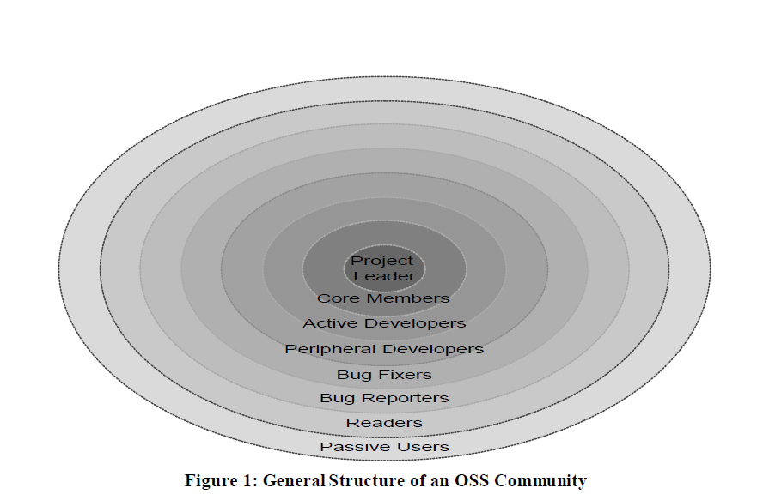
COMMUNITY STRUCTURE
（コミュニティの構造）
the role closer to the center has a larger influence（中心に近い役割のほうが影響力が大きい）

Slide 9
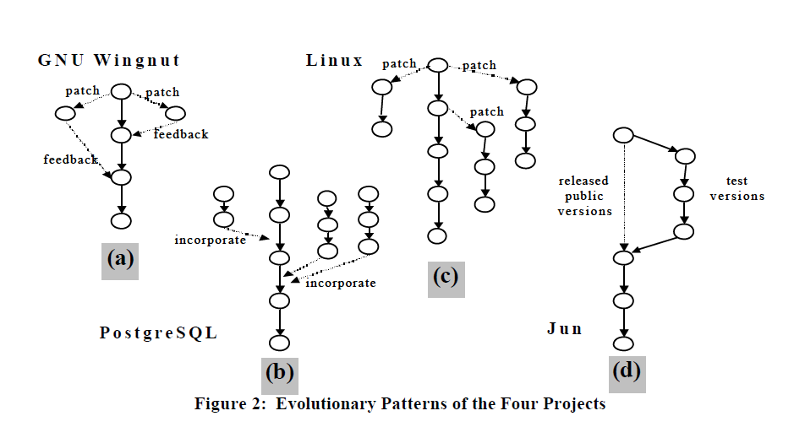
EVOLUTION OF SYSTEMS
（システムの進化）
Notes:
GNU aims to have a single, clean, nice, well-written version of implementation for a single piece of functionality.
In Linux, because there is much less motivation and encouragement for contributing back the developed patches, many branches evolved from a single program
In PostgreSQL, as new requirements emerge, Active Developers will organize a team to implement them.
However, these new implementation will exist for a relative long time as patches, and are incorporated into the core version only after they are approved by the Core Members.
Jun evolves also as a single-version tree
there are many branches of test versions created for internal usage
When the Project Leader decides that the system has been sufficiently tested, the tested version is released as a public version
GNUは、単一の機能を実装するための、単一の、クリーンで、素晴らしく、よく書かれたバージョンを持つことを目指しています。
Linuxでは、開発されたパッチに貢献する意欲と励ましがはるかに少ないため、多くのブランチが単一のプログラムから進化しました
PostgreSQLでは、新しい要件が出現すると、Active Developersはそれらを実装するチームを編成します。
ただし、これらの新しい実装はパッチとして比較的長期間存在し、コアメンバーによって承認された後にのみコアバージョンに組み込まれます。
ジュンは単一バージョンのツリーとしても進化します
内部使用のために作成されたテストバージョンの多くのブランチがあります
システムが十分にテストされているとプロジェクトリーダーが決定すると、テスト済みバージョンがパブリックバージョンとしてリリースされます。

Slide 10

EVOLUTION OF COMMUNITY
（コミュニティの進化）
evolution of an OSS community is brought about by the role changes of its members（OSSコミュニティの進化は、そのメンバーの役割の変化によってもたらされる）
As community members change the roles they play in the community, they also change the social dynamics, and reshape the structure, of the community（コミュニティのメンバーがコミュニティで果たす役割を変更すると、コミュニティの社会的ダイナミクスも変更され、構造が再構築される）
evolution of an OSS community is determined by two factors（コミュニティのメンバーがコミュニティで果たす役割を変更すると、コミュニティの社会的ダイナミクスも変更され、構造が再構築される）
  the existence of motivated members who aspire to play roles with larger influence（より大きな影響力を持つ役割を果たす意欲のあるメンバーの存在）
  the social mechanism of the community that encourages and enables such individual role changes.（そのような個々の役割の変更を奨励し、可能にするコミュニティの社会的メカニズム）

Slide 11
3 TYPES OF OSS PROJECTS
（3種類OSSプロジェクト）
EXPLORATION-ORIENTED OSS
（探査向けのOSS）
UTILITY-ORIENTED OSS
（実用向けのOSS）
SERVICE-ORIENTED OSS
（サービス向けのOSS）

Slide 12
EXPLORATION-ORIENTED OSS
（探査向けのOSS）
Aim: to push the frontline of software development collectively through the sharing of innovations
（目的：イノベーションの共有を通じて一貫したソフトウェア開発の最前線を推進する）
quality requirements are often very high
（品質要件は非常に高い）
becomes a learning resource for thousands of software developers
（数千のソフトウェア開発者向けの学習リソースになる）
must be developed and maintained by expert programmers, such as Project Leaders
（プロジェクトリーダーなどの専門のプログラマーが開発および保守する必要がある）
success of such OSS projects depends greatly on the vision and leadership of the Project Leader
（このようなOSSプロジェクトの成功は、プロジェクトリーダーのビジョンとリーダーシップに大きく依存する）
when the vision of the Project Leader conflicts with the needs of the majority of the OSS community members, forking might happen
（プロジェクトリーダーのビジョンが大多数のOSSコミュニティメンバーのニーズと対立する場合、分岐が発生する可能性がある）
Notes:
Exploration-oriented oss (GNU and Jun)
aims at pushing the frontline of software development collectively through the sharing of innovations embedded in freely shared OSS systems
Due to the epistemic nature of this OSS type, the quality requirements are often very high
Once the system is released publicly, it becomes a learning resource for thousands of software developers
Therefore, this type of software must be developed and maintained by expert programmers, such as Project Leaders, who often are the original developers and keep a tight control over the system in order to maintain the integrity of the system so that it reflects its original design goal
The success of such OSS projects depends greatly on the vision and leadership of the Project Leader. However, when the vision of the Project Leader conflicts with the needs of the majority of the OSS community members, forking might happen. A new OSS project and community will be spun off the original one and embark on a similar but different project

Slide 13
UTILITY-ORIENTED OSS
（実用向けのOSS）
developed because the developers cannot find an existing program that fulfills their needs completely
（開発者がニーズを完全に満たす既存のプログラムを見つけることができないために開発された）
developers decide to develop their own systems and put it on the web for others
（開発者は自分でシステムを開発し、他の人のためにウェブ上に置く）
a typical bazaar type software development-no centralized control exists
（バザール型ソフトウェア開発-集中管理は存在しない）
Notes:
Utility-oriented OSS – Linux
Most of such OSS systems consist of many relatively independent OSS programs, such as the device drivers in the Linux operation system, and those OSS programs are developed because the original developers cannot find an existing program that fulfills their needs completely
developers decide to develop their own systems and put it on the web for others to share.
a typical bazaar type software development. No centralized control exists.
Unlike the Exploration-Oriented OSS in which forking is rather rare and the evolution of the system takes place in the form of improving the original system (Figure 2a), Utility-Oriented OSS has a lot of forks, evolving in the form of developing new programs by reusing and modifying existing programs rather than replacing the old programs with the new ones (Figure 2c). This gives to the rise of multiple, often incompatible programs. Programs that implement the similar functionality compete with each other and evolve simultaneously, but the implementation that wins the most support in the community will finally excel and eliminate other competing versions. This evolution pattern can be called as the tournament style.
may not have an independent community
Because most such developers only want to develop a program for their own particular need, they remain to be Peripheral Developers.
Passive Users who just want to use the system need Readers and Peripheral Developers, who are able to match the unique needs of Passive Users to the right system, to help them choose the right configuration

Slide 14
UTILITY-ORIENTED OSS
（実用向けのOSS）
has a lot of forks, evolving in the form of developing new programs by reusing and modifying existing programs rather than replacing the old programs with the new ones
（古いプログラムを新しいプログラムに置き換えるのではなく、既存のプログラムを再利用および変更して新しいプログラムを開発するという形で進化する、多くの分岐点がある）
gives to the rise of multiple,
often incompatible programs
（複数の台頭をもたらし、 しばしば互換性のないプログラム）
programs that implement the similar functionality compete with each other, but the implementation that wins the most support in the community will finally excel and eliminate other competing versions
（同様の機能を実装するプログラムは互いに競合するが、コミュニティで最も多くのサポートを獲得したプログラムが勝つ）
This evolution pattern can be called as the tournament style
（この進化パターンはトーナメントスタイルと呼ぶことができる）
Notes:
Most of such OSS systems consist of many relatively independent OSS programs, such as the device drivers in the Linux operation system, and those OSS programs are developed because the original developers cannot find an existing program that fulfills their needs completely
developers decide to develop their own systems and put it on the web for others to share.
a typical bazaar type software development. No centralized control exists.
Unlike the Exploration-Oriented OSS in which forking is rather rare and the evolution of the system takes place in the form of improving the original system (Figure 2a), Utility-Oriented OSS has a lot of forks, evolving in the form of developing new programs by reusing and modifying existing programs rather than replacing the old programs with the new ones (Figure 2c). This gives to the rise of multiple, often incompatible programs. Programs that implement the similar functionality compete with each other and evolve simultaneously, but the implementation that wins the most support in the community will finally excel and eliminate other competing versions. This evolution pattern can be called as the tournament style.
may not have an independent community
Because most such developers only want to develop a program for their own particular need, they remain to be Peripheral Developers.
Passive Users who just want to use the system need Readers and Peripheral Developers, who are able to match the unique needs of Passive Users to the right system, to help them choose the right configuration

Slide 15
UTILITY-ORIENTED OSS
（実用向けのOSS）
may not have an independent community
（独立したコミュニティがない場合がある）
only want to develop a program for their own particular need, such developers remain to be Peripheral Developers
（特定のニーズに合わせてプログラムを開発したいだけで、そのような開発者は周辺開発者のまま）
Passive Users who just want to use the system need Readers and Peripheral Developers-to help them choose the right configuration
（システムを使用したいだけのパッシブユーザーには、適切な構成を選択するための読者と周辺開発者が必要）
Notes:
Most of such OSS systems consist of many relatively independent OSS programs, such as the device drivers in the Linux operation system, and those OSS programs are developed because the original developers cannot find an existing program that fulfills their needs completely
developers decide to develop their own systems and put it on the web for others to share.
a typical bazaar type software development. No centralized control exists.
Unlike the Exploration-Oriented OSS in which forking is rather rare and the evolution of the system takes place in the form of improving the original system (Figure 2a), Utility-Oriented OSS has a lot of forks, evolving in the form of developing new programs by reusing and modifying existing programs rather than replacing the old programs with the new ones (Figure 2c). This gives to the rise of multiple, often incompatible programs. Programs that implement the similar functionality compete with each other and evolve simultaneously, but the implementation that wins the most support in the community will finally excel and eliminate other competing versions. This evolution pattern can be called as the tournament style.
may not have an independent community
Because most such developers only want to develop a program for their own particular need, they remain to be Peripheral Developers.
Passive Users who just want to use the system need Readers and Peripheral Developers, who are able to match the unique needs of Passive Users to the right system, to help them choose the right configuration

Slide 16
SERVICE-ORIENTED OSS
（サービス向けのOSS）
aims at providing stable and robust services to all the stakeholders of OSS systems（OSSシステムのすべてのステークホルダーに安定したサービスを提供することを目指している）
stakeholder refer to both the member of the OSS community who uses the system and the end-user（ステークホルダーは、システムを使用するOSSコミュニティのメンバーとエンドユーザーの両方を指す）
any changes made to the system have to be carefully considered so that they do not disrupt its provided services（システムに加えられた変更は、提供されるサービスを中断させないように慎重に検討する必要がある）
usually very conservative against evolutionary and rapid changes（通常、進化的かつ急速な変化に対して非常に保守的）
centralized in the Council style - not controlled by any individual person（評議会スタイルで一個人によって管理されていない）
the Council is the assembly of the Core Members, who earn their rights by long-time devotion and contributions to the OSS community（評議会は、長年の献身とOSSコミュニティへの貢献が持っているコアメンバー）
Notes:
Service-oriented OSS-PostgreSQL system and the Apache Server
aims at providing stable and robust services to all the stakeholders of OSS systems
stakeholder to refer to both the member of the OSS community who uses the system and the end-user
Any changes made to the system have to be carefully considered so that they do not disrupt its provided services
usually very conservative against evolutionary and rapid changes
centralized in the Council style, it is not controlled by any individual person. The Council is the assembly of the Core Members, who earn their rights by long-time devotion and contributions to the OSS community

Slide 17

DISCUSSION
（考察）
Recognizing the differences of different types of OSS projects help OSS developers to identify their projects with a particular type and to take appropriate measures to guide the management and operation of the OSS project
（OSSプロジェクトの異なるタイプの違いを認識することは、OSS開発者が特定のタイプのプロジェクトを識別し、OSSプロジェクトの管理と運用をガイドする適切な手段を講じるのに役立つ）
Notes:
Recognizing the differences of different types of OSS projects help OSS developers to identify their projects with a particular type and to take appropriate measures to guide the management and operation of the OSS project.

Slide 18
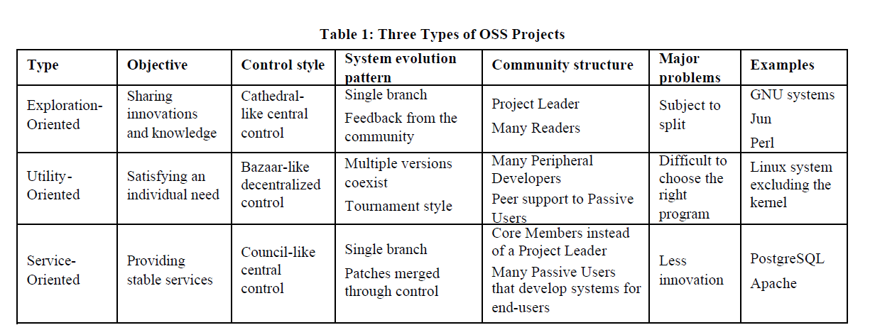
SUMMARY OF EACH TYPE
（各タイプの概要）

Slide 19
EVOLUTION OF OSS PROJECTS
（OSSプロジェクトの進化）
Exploration-Oriented OSS and Utility-Oriented OSS are good for the initiation of an OSS project, and Service-Oriented OSS is suitable for more mature OSS projects
（探査指向のOSSおよび実用指向のOSSは、OSSプロジェクトの開始に適しています。サービス指向のOSSは、より成熟したOSSプロジェクトに適している）
Exploration-Oriented OSS projects
（探査指向のOSSプロジェクト）
users at a certain point, will demand stability （特定の時点でのユーザーは、安定性を要求 ）
original Project Leader has lost his or her exploration spirit（元のプロジェクトリーダーは自分の探査精神を失いました ）
Utility-Oriented OSS projects
（実用指向のOSSプロジェクト）
developers of competing implementations for a similar functionality can join forces to create a team to develop a system collaboratively that accommodate the different needs of each developer（ 同様の機能の競合する実装の開発者は、各開発者のさまざまなニーズに対応するシステムを共同で開発するチームを作成するために力を合わせることができる）
Why need to mutate to Service-Oriented type?（なぜサービス指向型に変更する必要があるのですか？）
system has grown too large to be controlled by any single person（システムが大きくなりすぎて、一人で制御できない）
Notes:
Exploration-Oriented OSS and Utility-Oriented OSS are good for the initiation of an OSS project, and Service-Oriented OSS is suitable for more mature OSS projects.
Exploration-Oriented OSS will attract many followers, who, as users, at a certain point, will demand stability because they have invested many efforts in the OSS project and have used it to develop systems for end-users
it is probably better for the OSS project to mutate into the Service-Oriented type; otherwise, the OSS community may split or the OSS system is simply abandoned by most community members
may also mutate into a Service-Oriented type simply because the original Project Leader has lost his or her exploration spirit, or because the system has grown too large to be controlled by any single person
Utility-Oriented OSS projects can also mutate into Service-Oriented ones. Developers of competing implementations for a similar functionality can join forces to create a team to develop a system collaboratively that accommodate the different needs of each developer

Slide 20
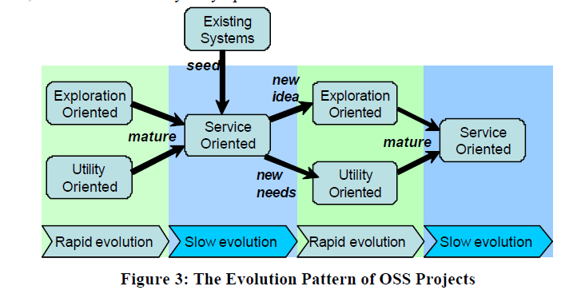
EVOLUTION OF OSS PROJECTS
（OSSプロジェクトの進化）
Exploration-Oriented and Utility-Oriented OSS projects experience rapid evolution, mostly in linear fashion（探査指向および実用指向のOSSプロジェクトは、ほとんど直線的に急速に進化する）
As the projects mature into Service-Oriented ones, the speed of evolution will slow down to a stable growth（プロジェクトがサービス指向のものに成熟するにつれて、進化の速度は安定した成長に減速する）
A new round of rapid evolution will start again if the stable OSS system inspires new ideas or new requirements, giving birth to New Exploration-Oriented or Utility-Oriented OSS projects, which will again mature into new Service-Oriented ones（安定したOSSシステムが新しいアイデアや新しい要件を刺激し、新しい探査指向または実用指向のOSSプロジェクトが生まれ、新しいサービス指向のプロジェクトに再び成長すると、急速な進化の新しいラウンドが再び始まる）
similar to the biological evolutionary process（生物学的進化プロセスに類似）
Notes:
Figure 3 hypothesizes a possible sustainable evolution pattern of OSS projects. Exploration-Oriented and Utility-Oriented OSS projects experience rapid evolution, mostly in linear fashion
As the projects mature into Service-Oriented ones, the speed of evolution will slow down to a stable growth. A new round of rapid evolution will start again if the stable OSS system inspires new ideas or new requirements, giving birth to New Exploration-Oriented or Utility-Oriented OSS projects, which will again mature into new Service-Oriented ones
similar to the biological evolutionary process

Slide 21

CONCLUSION
（まとめ）
As Open-Source gains popularity, many software development approaches are labeled Open-Source simply because one property of the outcome is Open-Source
（オープンソースの人気が高まるにつれて、多くのソフトウェア開発アプローチはオープンソースとラベル付けされている）
However, objectives, motivations, collaboration models, system evolution patterns, and community structures and evolution patterns differ significantly from projects to projects. （ただし、目的、動機、コラボレーションモデル、システムの進化パターン、コミュニティ構造と進化パターンは、プロジェクトごとに大きく異る）
Rather than focusing on the common features of all Open-Source projects, this paper attempted to systematically treat the differences of OSS projects by examining the evolution patterns of systems and communities（この論文では、すべてのOSSプロジェクトの共通機能に焦点を当てるのではなく、システムとコミュニティの進化パターンを調べることで、OSSプロジェクトの違いを体系的に扱うことを試みました）
Through analyzing a case study of four typical OSS projects, we proposed three types of OSS projects（4つ典型的なOSSプロジェクトのケーススタディを分析することにより、3種類のOSSプロジェクトを提案しました）
Understanding the difference of the different types of OSS projects is the first step to build a theory that can guide the development of OSS projects（OSSプロジェクトの異なるタイプの違いを理解することは、OSSプロジェクトの開発を導くことができる理論を構築する最初のステップ）
Notes:
As Open-Source gains popularity, many software development approaches are labeled Open-Source simply because one property of the outcome is Open-Source
However, objectives, motivations, collaboration models, system evolution patterns, and community structures and evolution patterns differ significantly from projects to projects.
Rather than focusing on the common features of all Open-Source projects, this paper attempted to systematically treat the differences of OSS projects by examining the evolution patterns of systems and communities.
Through analyzing a case study of four typical OSS projects, we proposed three types of OSS projects. Understanding the difference of the different types of OSS projects is the first step to build a theory that can guide the development of OSS projects.

