Slide 1
EARLY IDENTIFICATION OF FUTURE COMMITTERS IN OPEN SOURCE SOFTWARE PROJECTS
オープンソースソフトウェアプロジェクトにおける早期に
コミッター候補者の発見
NUR ATHIRAH
60226192

Slide 2
TABLE OF CONTENTS
(目次）
WHAT IS A COMMITTER? （コミッターとは）
WHAT DOES COMMITTER DO? （コミッターの仕事）
WHAT DOES DEVELOPER DO? （開発者の仕事）
EXPERIMENT SETTINGS （実験設定）
RESULT （結果）
DISCUSSION （考察）
CONCLUSION （まとめ）

Slide 3

What is a committer?
（コミッターとは）
Have permission to commit edited source code to the Version Control System(VCS)
Such permission is given to a very limited number of developers
Small number of committers
  To maintain high quality of their source code

Slide 4
What does committer do?
（コミッターの仕事）
Triaging bugs
Receive a large number of feature requests and bug reports
Assigning bugs
Assign the requests to developers
Verifying bugs
Have to verify patches that developers made to fix the bug
After that committers commit the fixed source code to the VCS of the project
In some cases, bugs have to be re-opened
Notes:
Triaging bugs:
Committers receive a large number of feature requests and bug reports
Rastkar-built a system to automatically summarize bug reports
Hooimeijer-presented a method to identify the bug reports that should be fixed first
Assigning bugs:
Committers should assign the requests to developers who have the appropriate skills to solve the request
Anvik and Cubranic-presented an approach to identify the most suitable developer for a bug report based on textual information
Verifying bugs
Committers have to verify patches that developers made to fix the bug
After that committers commit the fixed source code to the VCS of the project
In some cases, bugs have to be re-opened(may increase maintenance costs and lead to unnecessary rework by busy developers)
Shihab-presented an approach to identify whether a bug will re-opened

Slide 5
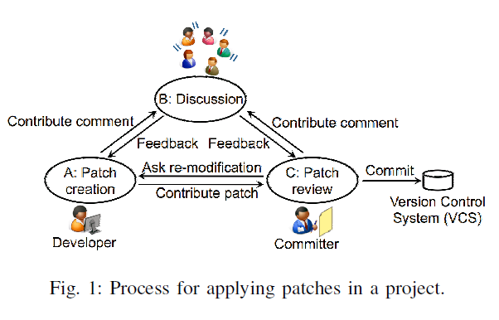
What does developer do ?
（開発者の仕事）
A)Patch creation
（パッチ投稿）
Developers create patches to extend functionality and to fix bugs
B)Discussion
（ディスカッション）
Developers discuss the creation of patches and review each other‘s patches
C)Patch verification
（パッチ検証）
Committers verify the contributed patches
Then they contribute patches to a bug tracking system(BTS)
In this study, developer who contributed a patch is regarded as the developer who created the patch
If they judge that a patch:
should be edited again: they will ask the developers to re-edit the source code
Doesn’t need to be edited: the committers would commit the patch to the VCS on behalf of the developers
They discuss their plans and designs

Slide 6
Popularity of an OSS project increase (OSSプロジェクトの人気が 増加) | Number of contributed patches increase （パッチの数も増加）
Difficult for committers to manage them
（管理するのが困難）
Increase the number of committers
（コミッターの数を増える）

Slide 7
Most large-scale OSS projects have more than 10,000 developers
（ほぼOSSプロジェクトは10,000以上開発者が参加）
Difficult to identify a potential committers
（コミッター候補者を発見する事は困難）
A developer is promoted to be a new committer through the recommendation of current committers
（一般的に既存コミッターの推薦からコミッター候補者になる）
To avoid the loss of capable developers, one need to identify future committers as soon as possible
（有能な開発者の損失を避けるために、早期にコミッター候補者を発見する事は大事）
The committers do not know whether a developer recommended by committers will continue to contribute to the project for a long time
（推薦された開発者がそのプロジェクトに関して長い間働くかどうかわからない）

Slide 8
In this study, to identify future committers:
Developers activities were analyzed (number of contributed patches and comments)
A committer-identification model was built using these metrics(to predict whether a particular developer will become a committer during our target period)
Prior studies aim to provide techniques for the effective use of the limited human resources of a few committers
On the other hand, the goal of this study is to increase the human resources by recommending additional capable committers

Slide 9
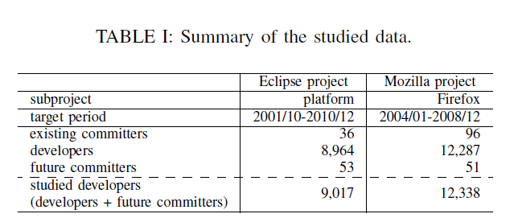
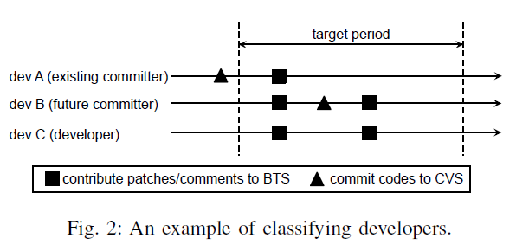
EXPERIMENT SETTINGS
（実験設定）
A) Target data （対象データ）
Data from the Eclipse and Mozilla projects are used
Some developers are already committers
Existing committers（既存開発者）
  Have committed source code to VCS before the studied period
Future committer （コミッター候補者）
  Commits patches for the first time during the studied period
Developer（一般開発者）
  Never committed anything to VCS since the project's start and throughout the studied period
Notes:
A) Target data （対象データ）
Data from the Eclipse and Mozilla projects are used
The studied period and the number of developers in each project are presented in table 1
Some developers are already committers
Existing committers-have committed source code to VCS before the studied period
Developer is described as a future committer in this study:
commits patches for the first time during the studied period
never committed anything to VCS since the project's start and throughout the studied period

Slide 10
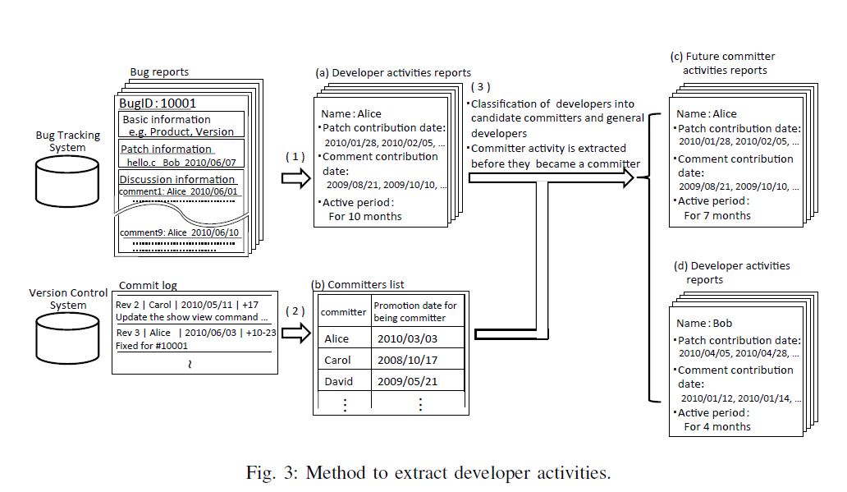
EXPERIMENT SETTINGS
（実験設定）
B) Extracting Metrics （データを抽出）
The metrics were extracted from the Bugzilla data
Steps to extract the metrics:
(1)Extracting developer activities from BTS data
(2)Extracting the promotion date for becoming a committer from VCS data
(3)Classifying the developer activities reports
Notes:
B) Extracting Metrics （データを抽出）
The metrics were extracted from the Bugzilla data
Figure 3 shows the procedure used to extract metrics using the BTS and VCS data
(1)Extracting developer activities from BTS data
(2)Extracting the promotion date for becoming a committer from VCS data
(3)Classifying the developer activities reports

Slide 11
RESULTS
（結果）
RQ1:Are there any difference in the activities of future committers and developers?
（コミッター候補者と一般開発者の活動に違いがある？）
RQ2:Which developer activities lead to early promotion to a committer role?
（早期にコミッター昇格ために、有用な活動量は何か）
RQ3:How accurate is a committer-identification model built using developer activities?
（開発者の活動量から構築した予測モデルはどの程度で正確なのか？）

Slide 12
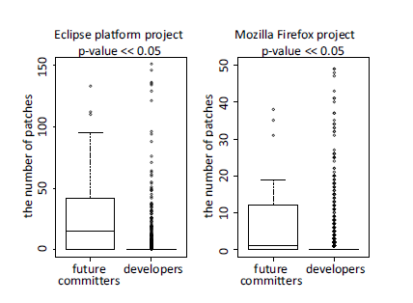
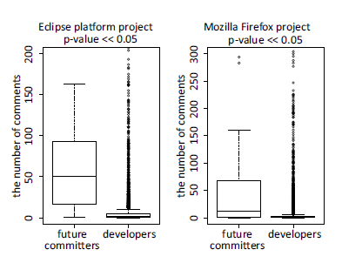
RQ1:Are there any difference in the activities of future committers and developers?
（コミッター候補者と一般開発者の活動に違いがある？）
Fig. 4: Differences of the number of patches between committers and developers
Fig. 5: Differences of the number of comments between future committers and developers
The differences in the amount of activities between future committers and developers are presented in Fig. 4 and 5
The amount of activities by future committers is higher than the amount of activities by developers
Notes:
The differences in the amount of activities between future committers and developers are presented in Fig. 4 and 5
Figure 4 shows the distribution of the number of contributed patches in the Eclipse platform and Mozilla Firefox projects by future committers and by developers
Figure 5 shows the distribution of the number of contributed comments by future committers and by developers.
The amount of activities by future committers is higher than the amount of activities by developers
These metrics (the number of submitted patches/comments) are useful in identifying future committers.

Slide 13
RQ2:Which developer activities lead to early promotion to a committer role?
（早期にコミッター昇格ために、有用な活動量は何か）
RQ2-1: Is there a difference in activities of rapidly-promoted committers and the activities of regularly-promoted committers?
RQ2-2: What do regularly-promoted committers do more than the rapidly-promoted committers?

Slide 14
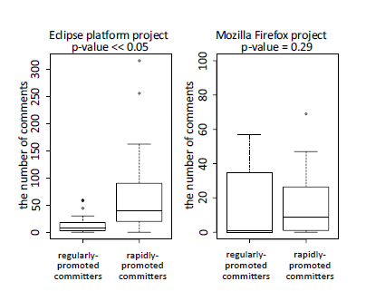
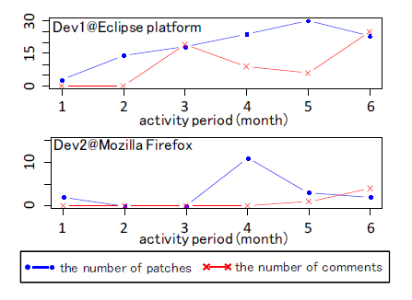
RQ2-1: Is there a difference in activities of rapidly-promoted committers and the activities of regularly-promoted committers?
The number of activities performed by rapidly-promoted committers is more than regularly-promoted committers.
Fig. 7: Differences of the number of patches of regularly-promoted committers and rapidly-promoted committers
Fig. 9: Activity change of rapidly-promoted committers.

Slide 15
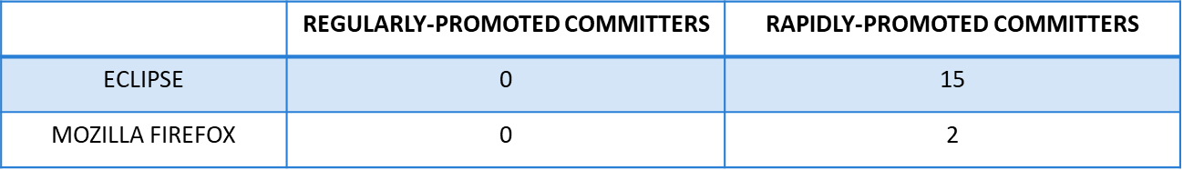
RQ2-1: Is there a difference in activities of rapidly-promoted committers and the activities of regularly-promoted committers?
Median number of contributed patches
Median number of contributed patches by regularly-promoted committers is less than the number of contributed patches by the rapidly-promoted committers

Slide 16
RQ2-1: Is there a difference in activities of rapidly-promoted committers and the activities of regularly-promoted committers?
(B) Median number of contributed comments
The median number of contributed comments by regularly-promoted committers is less than the number of contributed comments by the rapidly-promoted committers
#In the Mozilla Firefox project, there is no significant difference in the number of activities between the regularly-promoted committers and the rapidly-promoted committers
 | REGULARLY-PROMOTED COMMITTERS | RAPIDLY-PROMOTED COMMITTERS
ECLIPSE | 9 | 41
MOZILLA FIREFOX | 1 | 11

Slide 17
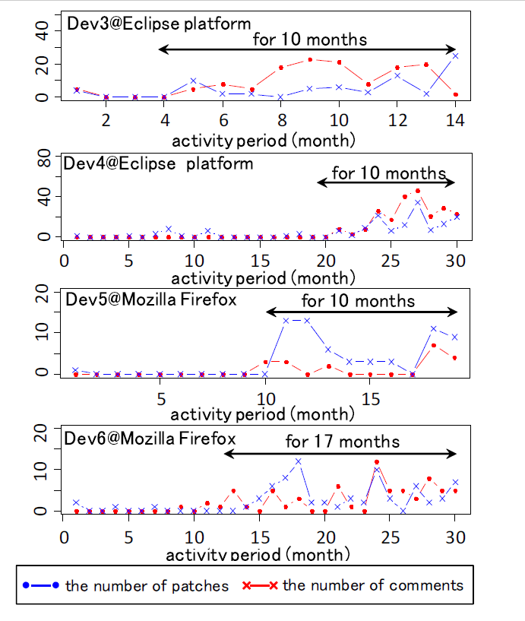
RQ2-2: What do regularly-promoted committers do more than the rapidly-promoted committers?
Fig. 9: Activity change of rapidly-promoted committers
Fig. 10: Activity change of regularly-promoted committers

Slide 18
RQ2-2: What do regularly-promoted committers do more than the rapidly-promoted committers?
The amount of activities by regularly-promoted committers is fewer than the rapidly-promoted committers at the beginning of their time
However, the regularly-promoted committers gradually increase the amount of their activities, and they became committers after they have worked actively for 1-1.5 years
Few developers continue actively work for about a year
Most developers who have actively worked for about 1-1.5 years are promoted to committer role
The amount of contribution in the time period just before the promotion plays a big part in the committer promotion.

Slide 19
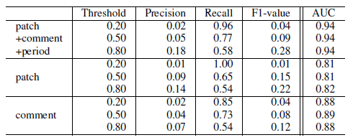
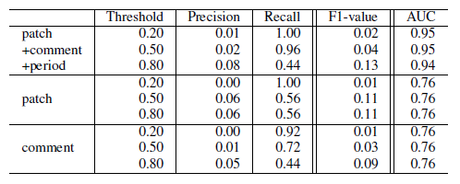
RQ3:How accurate is a committer-identification model built using developer activities?
（開発者の活動量から構築した予測モデルはどの程度で正確なのか？）
TABLE III: Committer prediction results in Eclipse platform project
A very strong AUC of the model using all activities
The AUC:
  Eclipse: 0.94
  Mozilla Firefox: 0.95
The model had higher accuracy than the random predictor->AUC is considerably higher than 0.5 in both projects
Precision and recall using all metrics are:
  about 18% and 58% in the Eclipse platform project (at 0.80 threshold)
  about 8% and 44% in Mozilla Firefox project (at 0.8 threshold)
TABLE IV: Committer prediction results in Mozilla Firefox project

Slide 20
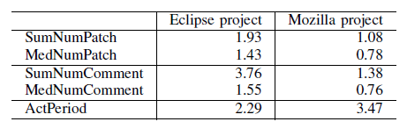
RQ3:How accurate is a committer-identification model built using developer activities?
（開発者の活動量から構築した予測モデルはどの程度で正確なのか？）
TABLE V: Variable importance measure
SumNumComment（総コメント投稿数） and ActPeriod（活動期間） are the most important factors in identifying future committers in both projects
Not just technical contributions(i.e., patch contributions), social contributions (i.e., comment contributions) also play a role in the promotion decision
The role of social contributions (3.76/1.38) is even larger than technical contributions (1.93/1.08) in both projects.
The role of social contributions (3.76) is strong compare to activity period (2.29) in the Eclipse project.
Our committer-identification model considerably outperforms a random predictor
Notes:
By examining the variable importance measure, factors which influence the random forest predictor the most can be known
Table V shows the median value of each variable
SumNumComment and ActPeriod are the most important factors in identifying future committers in both projects
Not just technical contributions(i.e., patch contributions), social contributions (i.e., comment contributions) also play a role in the promotion decision
The role of social contributions (3.76/1.38) is even larger than technical contributions (1.93/1.08) in both projects.
The role of social contributions (3.76) is strong compare to activity period (2.29) in the Eclipse project.

Slide 21
DISCUSSION
（考察）
TABLE VI: NUMBER OF FUTURE COMMITTERS THAT HAVE BEEN PROMOTED AS A COMMITTER DURING TARGET PERIOD AND AFTER A YEAR
 | FUTURE COMMITTER | AFTER A YEAR
ECLIPSE | 53 | 40
MOZILLA FIREFOX | 51 | 30
Activities after becoming a committer（コミッター昇格後の活動）
Does future committers actively work after they become committers ?
  The future committer activities after became a committer were analyzed
  Regularly-promoted committers may lose their motivation because they have already worked as developers for more than a year
Notes:
Activities after becoming a committer（コミッター昇格後の活動）
Does future committers actively work after they become committers ?
The future committer activities after became a committer were analyzed
Regularly-promoted committers may lose their motivation because they have already worked as developers for more than a year
For new committers who have worked only for a short period of time before being promoted

Slide 22
DISCUSSION
（考察）
Rapidly-promoted committer activities and the regularly-promoted committer activities after they became committers
  The median number of comments and the median number of commits to VCS by the rapidly-promoted committers are higher than those by the regularly-promoted committers
The results highlight the importance of early identification of strong developers and their rapid promotion to committer roles.
In fact, rapidly-promoted committers actively contribute more than regularly-promoted committers.

Slide 23
DISCUSSION
（考察）
Threats to validity（本論文の制約）
The date when a developer commits to VCS for the first time - the date of promotion to committer
Some developer may get permission to commit patches before the date of promotion to become a committer
Focused on developer activities in the patch contribution and integration process
Many other types of activities (such as the number of edited lines of code, the source code quality, and the content of comments) that could be studied in future work
Notes:
We defined the date when a developer commits to VCS for the first time as the date of promotion to committer.
However, in some rare cases a developer may get permission to commit patches before the date of promotion to committer.
We focused on developer activities in the patch contribution and integration process.
There exists many other types of activities (such as the number of edited lines of code, the source code quality, and the content of comments) that could be studied in future work.

Slide 24
CONCLUSION
（まとめ）
The goal is to be able identify future committers easier
Developer activities was analyzed and a committer-identification model was built to identify future committers among the thousands of developers in an OSS project
Using data from the Eclipse platform and Mozilla Firefox projects:
RQ1:Are there any difference in the activities of future committers and developers?
The amount of activity by a future committer is higher than the activity of a developer
RQ2:Which developer activities lead to early promotion to a committer role?
Regularly-promoted committers have actively worked for 1-1.5 years before they become committers
RQ3:How accurate is a committer-identification model built using developer activities?
Our committer-identification model outperforms a random predictor
After the promotion, rapidly-promoted committers were more active regularly-promoted committers
Enhance the committer-identification model
Notes:
After the promotion, rapidly-promoted committers were more active regularly-promoted committers
Enhance the committer-identification model
By integrating new metrics which will capture other types of developer activities

