Slide 1
Does the Initial Environment Impact the Future of Developers?
ICSE’11 pp.271--280
Minghui Zhou
Audris Mockus

Slide 2
INTRODUCTION
The developers need technical and social skills
To achieve socio-technical balance is hard
  cuz. the initial environment impacts on the individual
  e.g. offshoring projects
    the offshore team needs time working with onshore developers because nobody could get trained
They investigate how the initial environment impacts the developers’ learning trajectories

Slide 3
THE GOAL and APPROACHES
The Goal
  To investigate how the initial environment impacts the developers’ learning trajectories
Challenges to proceed with this investigation
  To measure the socio-technical balance
  To determine how the initial environment affects trajectories of developers

Slide 4
RELATED WORK (1/2)
Discover the nature of communications
  Communication plays an important role for developers ( Begel et al. ICSE’10)
  The quality of communication experience is important ( Nakakoji et al. KCSD’09)
Determine the impact the communications
  The lack of communication indicates a potential problem ( Cataldo et al. ESEM’08, CSCW’06)

Slide 5
RELATED WORK (2/2)
Studying the influence of the environment
  Conway’s Law (Conway. Datamation’68)
  Environmental change was associated with reductions in software quality (Mockus. FSE’10)
Proposing practice of socio-technical congruence
  The productive developers tend to change their use of communication media (Cataldo et al. CSCW’06)
  To proposed a socio-technical framework to provide support of information acquisition (Ye et al. FSE’07)

Slide 6
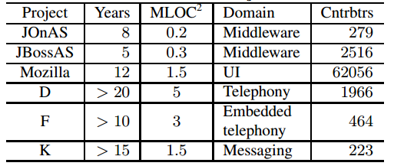
METHODOLOGY
Projects

Slide 7
(1) RETRIVE RAW DATA
Open Source : JIRA and Bugzilla
Commercial : Modification Request history data
To make a workflow graph
  Transfer of MR ownership indicates communication
Given the minimum of 28 months of tenure for the selected sample of contributors

Slide 8
(2) CLEAN RAW DATA
A contributor ID has changed over time
To identify the mapping between people and dev ID
  If the joining date of one ID followed the last contribution date of another ID associated with the same name
  If logins were “webmaster”, “cqadmin”, “mozilla” and “bugzilla*” we excepted them

Slide 9
(3) DETERMINE THE QUESTIONS
RQ:
  Does the project environment affects a developer future trajectory of relative sociality?
In order to answer the RQ
  to measure the developer’s technical achievement
  to measure the developer’s social activities

Slide 10
(3) MEASURE SOCIO-TECHNICAL
Technical learning : NumMRs
  the developer participated in during a month
  e.g Alice has been involved in two MRs, NumMRs = 2
Social learning : NumLogins
  a developer by adding up all the working relationship
  e.g Alice has been involved in two MRs: in one MR she received work from Tom and Jerry, and in another MR from Kiki and Jerry, NumLogins = 3

Slide 11
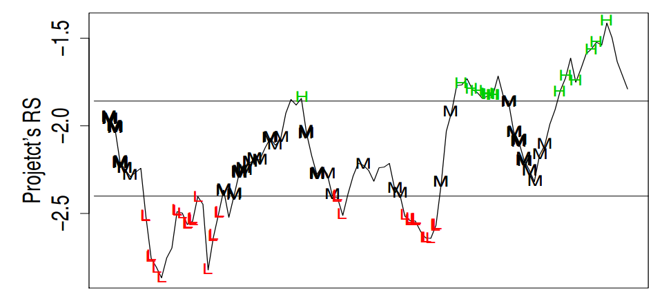
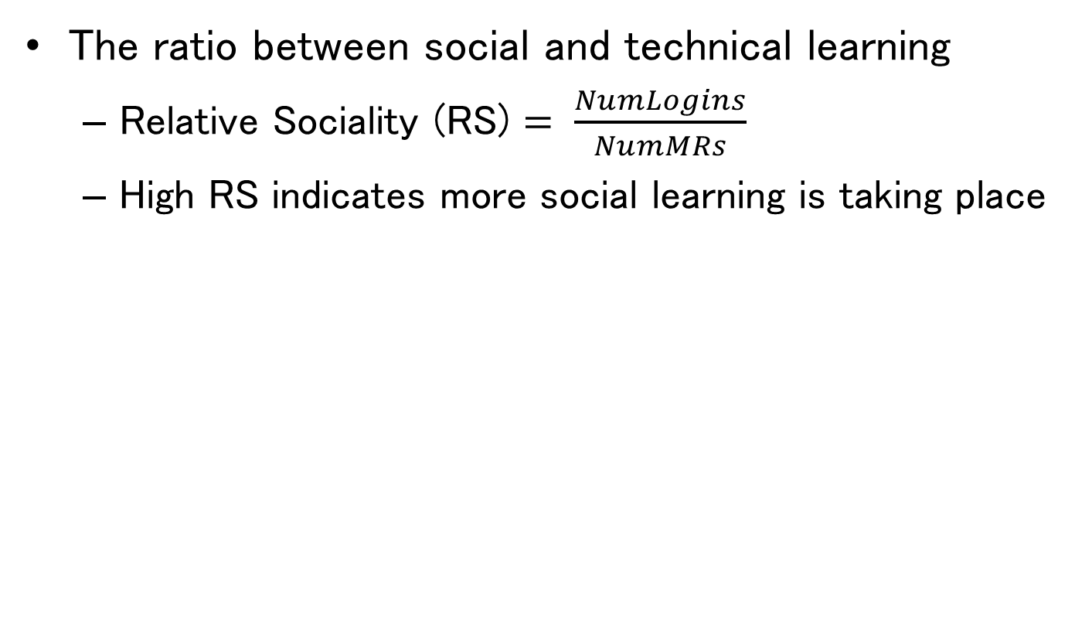
(3) MEASURE SOCIO-TECHNICAL
The ratio between social and technical learning
  Relative Sociality (RS) $= \frac{NumLogins}{NumMRs}$
  High RS indicates more social learning is taking place

Slide 12
HYPOTHESES
H1 : The social environment of the project when a developer joins affects her future trajectory
H2 : Low values of sociality measure increases the probability that this dev will become one of LTCs
H3 : The intensity of developers joining a project is high when the project’s sociality is high

Slide 13
HYPOTHESES
H4 : The intensity of LTCs joining an open source project is high when the project sociality is low
H5 : The LTCs joining at different levels of project’s RS follow distinct RS trajectories

Slide 14
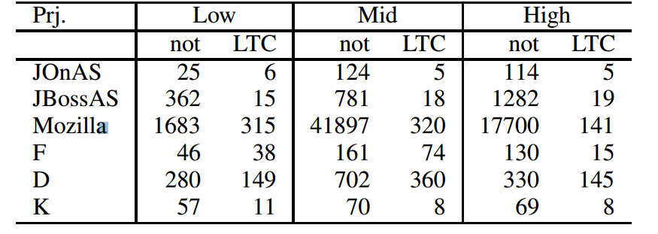
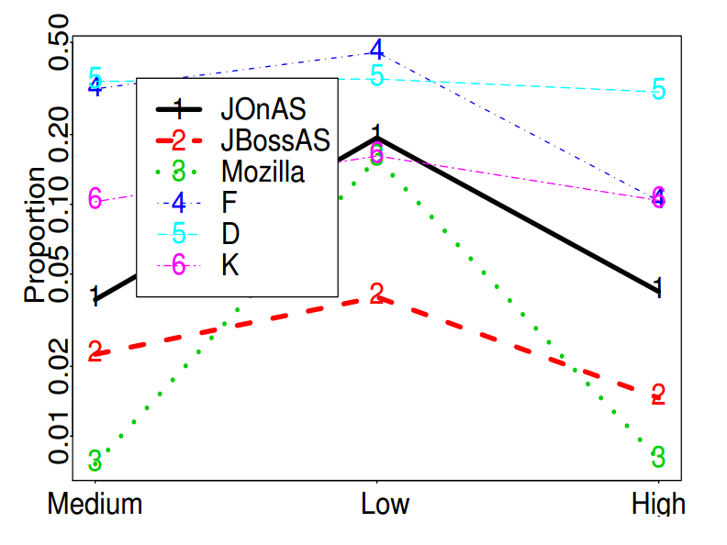
RESULTS
H2 : Low values of sociality measure increases the probability that this dev will become one of LTCs
Logistic regression
  L = Initial + Type + Project
  High 22% vs Low 68%

Slide 15
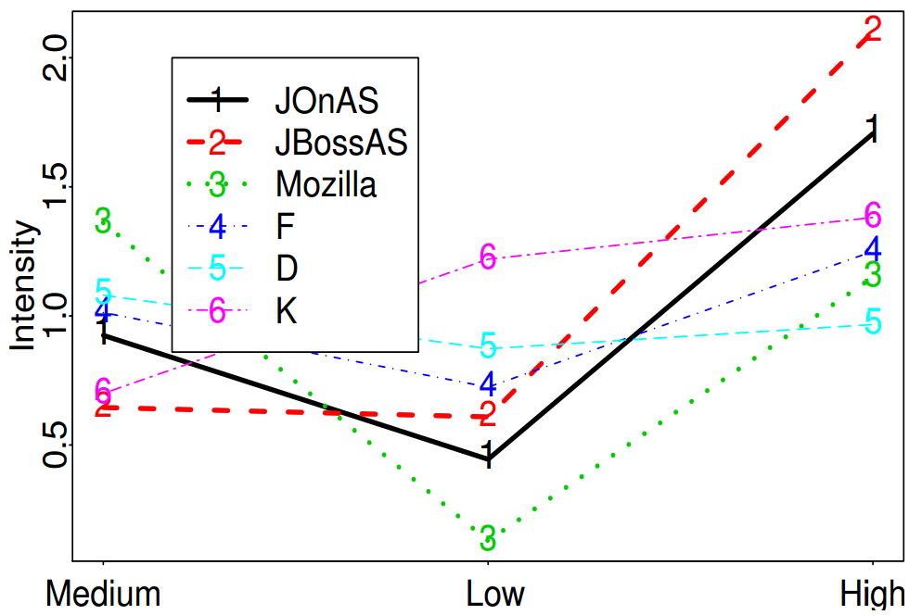
RESULTS
H3 : The intensity of developers joining a project is high when the project’s sociality is high

Slide 16
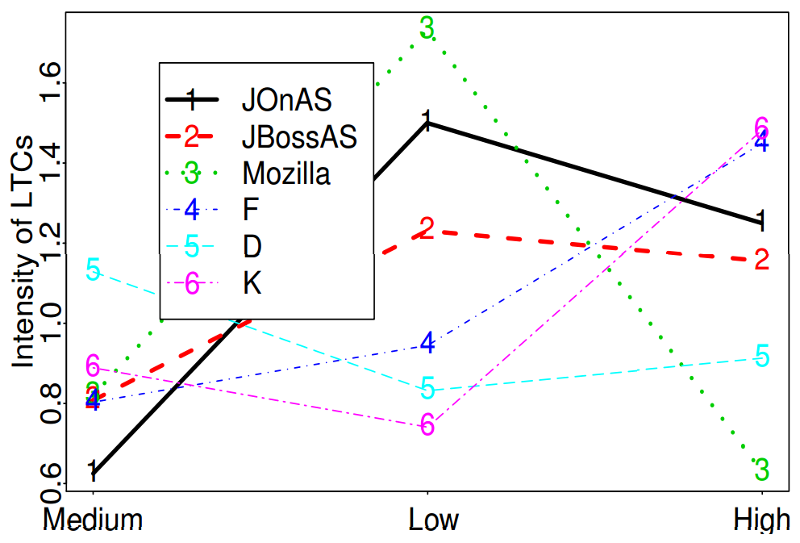
RESULTS
H4 : The intensity of LTCs joining an open source project is high when the project sociality is low

Slide 17
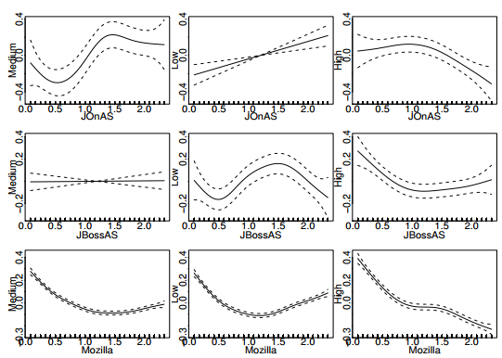
RESULTS
H5 : The LTCs joining at different levels of project’s RS follow distinct RS trajectories

Slide 18
Summary
  They investigated how the initial environment impacts the developers’ learning trajectories
  Finding
    the probability that a new developer will become one of LTC is highest when the project sociality is low
    times of high sociality are associated with a higher intensity of new contributors joining the project
    the open source and commercial projects exhibit different nature in the relationship between developer’s tenure and the project’s environment

